Slide 1
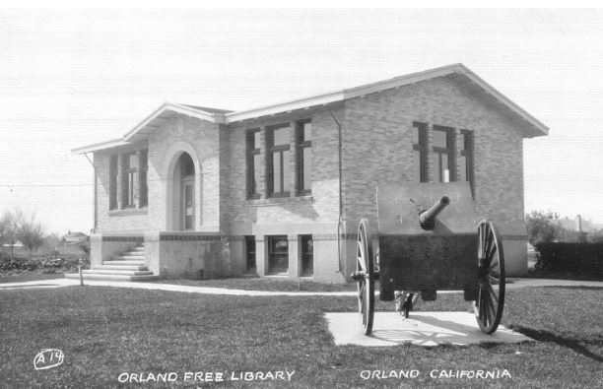

Orland Carnegie Center
April 15, 2025

Slide 2
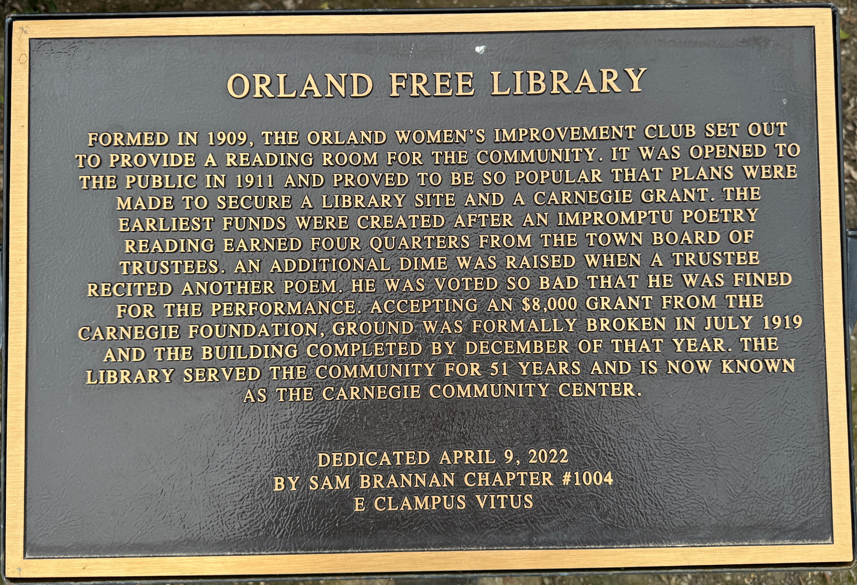

Orland Carnegie Center
April 15, 2025

Slide 3
Introduction
Andrew Carnegie, a philanthropist and industrialist, was deeply influenced by Vitruvian architectural principles—commodity, firmness, and delight—when funding the creation of public libraries across the United States.
Commodity (Utility): Carnegie believed that libraries should serve the practical needs of the community. He wanted the buildings to be functional and accessible, providing a space where people could easily access information and educational resources. He ensured that the libraries were designed to accommodate large numbers of visitors and offered a variety of spaces for different activities—reading rooms, children's areas, and even lecture halls.
Firmness (Stability and Durability): Reflecting Vitruvius's emphasis on the strength and longevity of a structure, Carnegie insisted that the libraries be robust and enduring. This was symbolized in the use of high-quality materials, such as stone and brick, which not only ensured the buildings would last but also conveyed the importance of education as a lasting investment in the community.
Delight (Aesthetic Appeal): Carnegie understood that public buildings, especially libraries, should be inspiring and uplifting. He wanted the architecture to inspire a sense of awe and pride in the community. Influenced by classical designs, many of Carnegie’s libraries featured elegant facades, grand staircases, and decorative elements that reflected the dignity and beauty of learning, thereby delighting both users and visitors.
By adhering to these Vitruvian principles, Carnegie’s libraries were not just utilitarian structures; they became symbols of the importance of education and culture, providing practical resources while also enriching the community's intellectual and aesthetic life.
Orland Carnegie Center
April 15, 2025

Slide 4
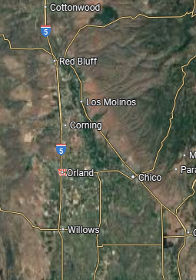
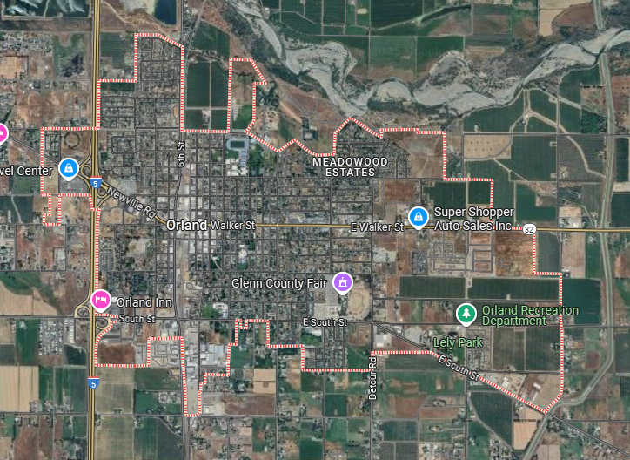
Context
Orland Carnegie Center
April 15, 2025

Slide 5
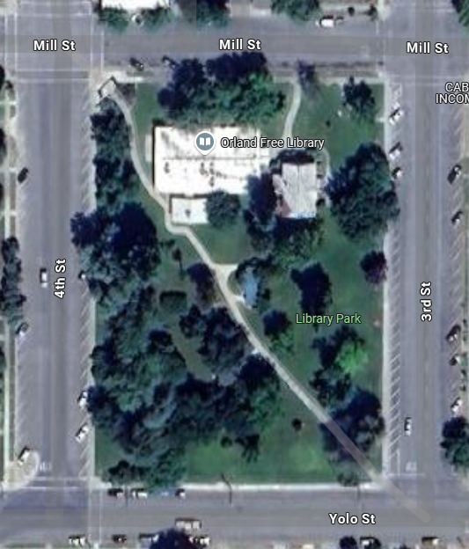
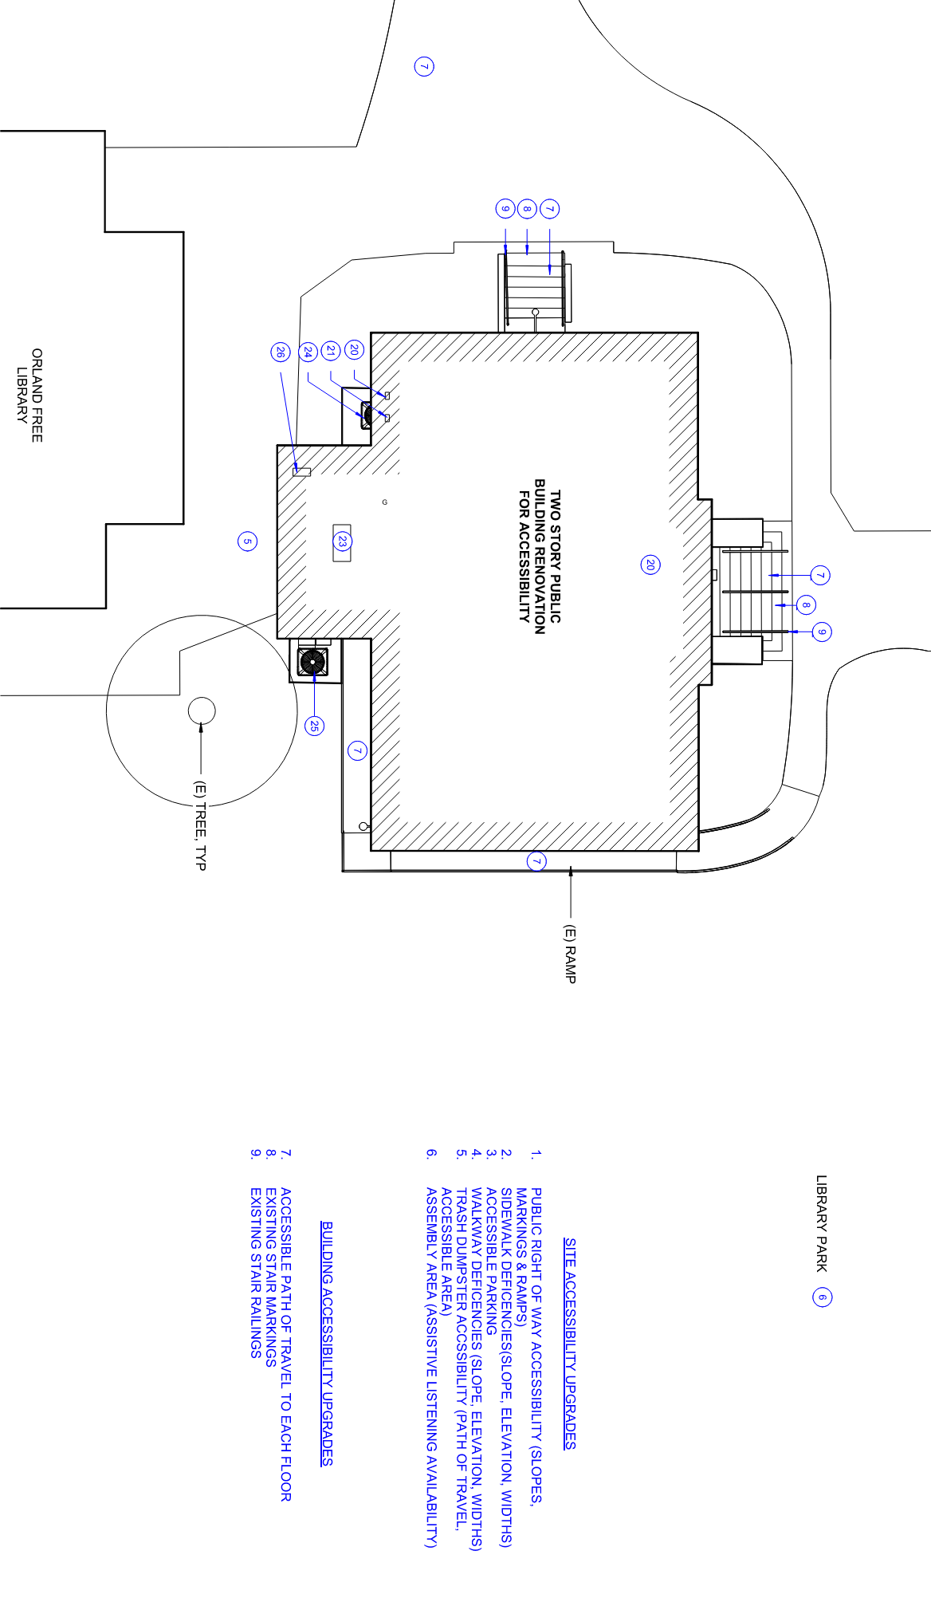
Orland Carnegie Center
April 15, 2025

Slide 6
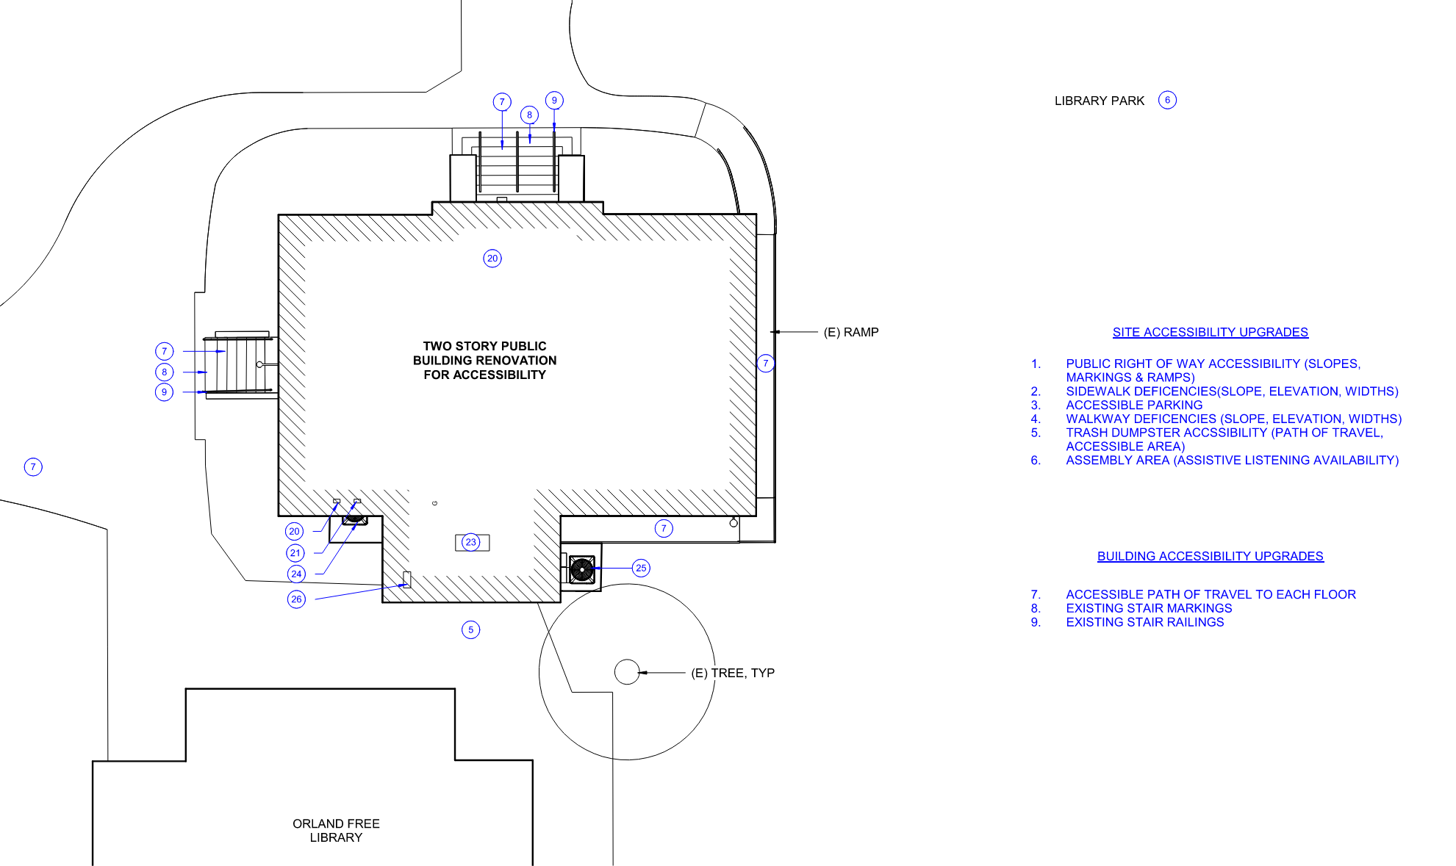
Accessibility
(commodity)
Aesthetics (delight)
Building Systems
(firmness)
Orland Carnegie Center
April 15, 2025

Slide 7
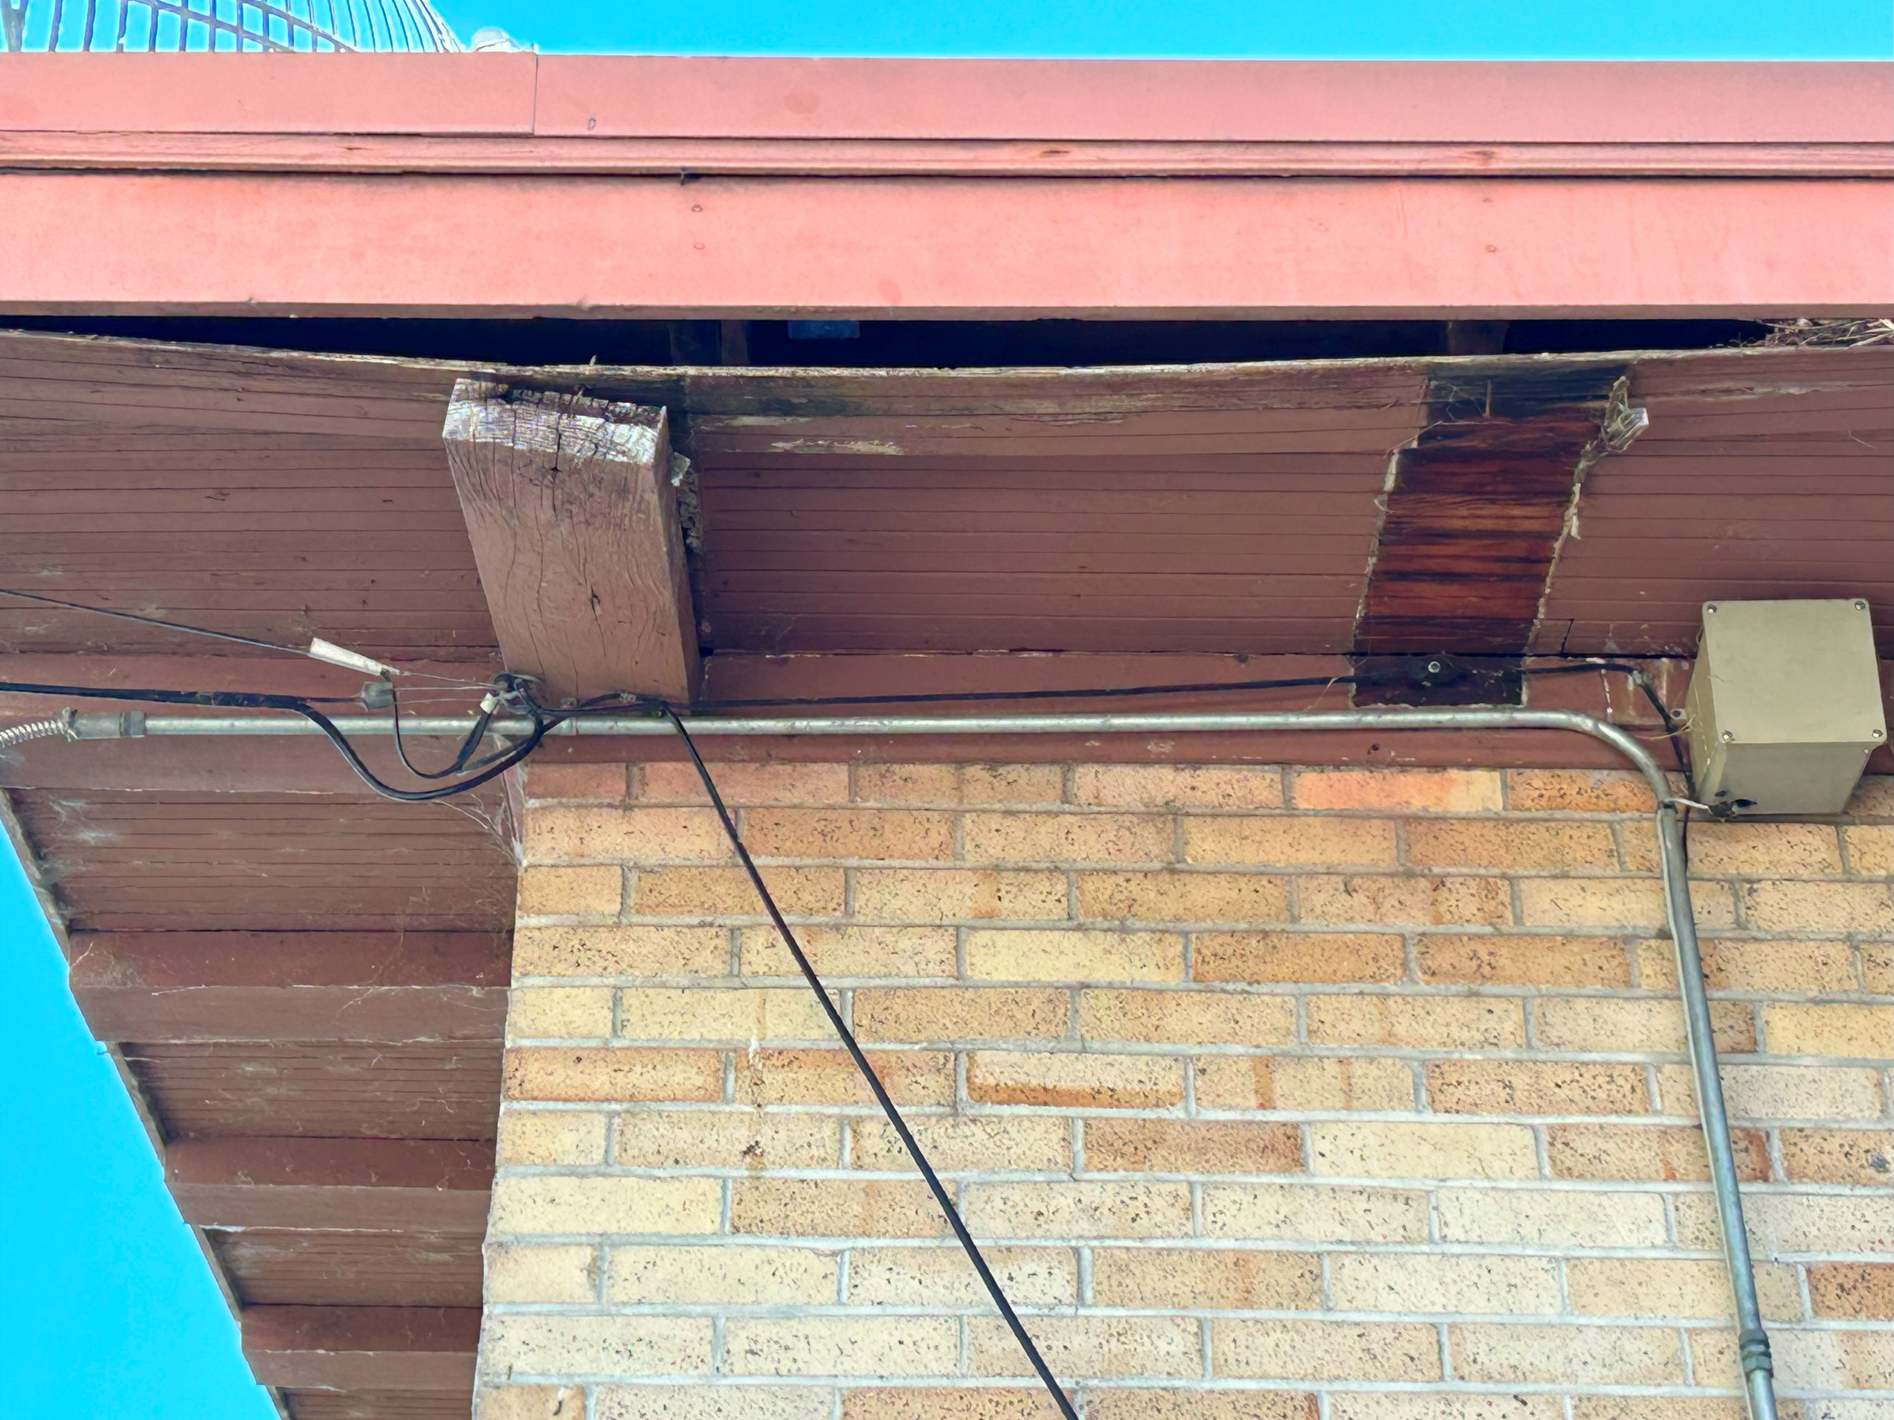
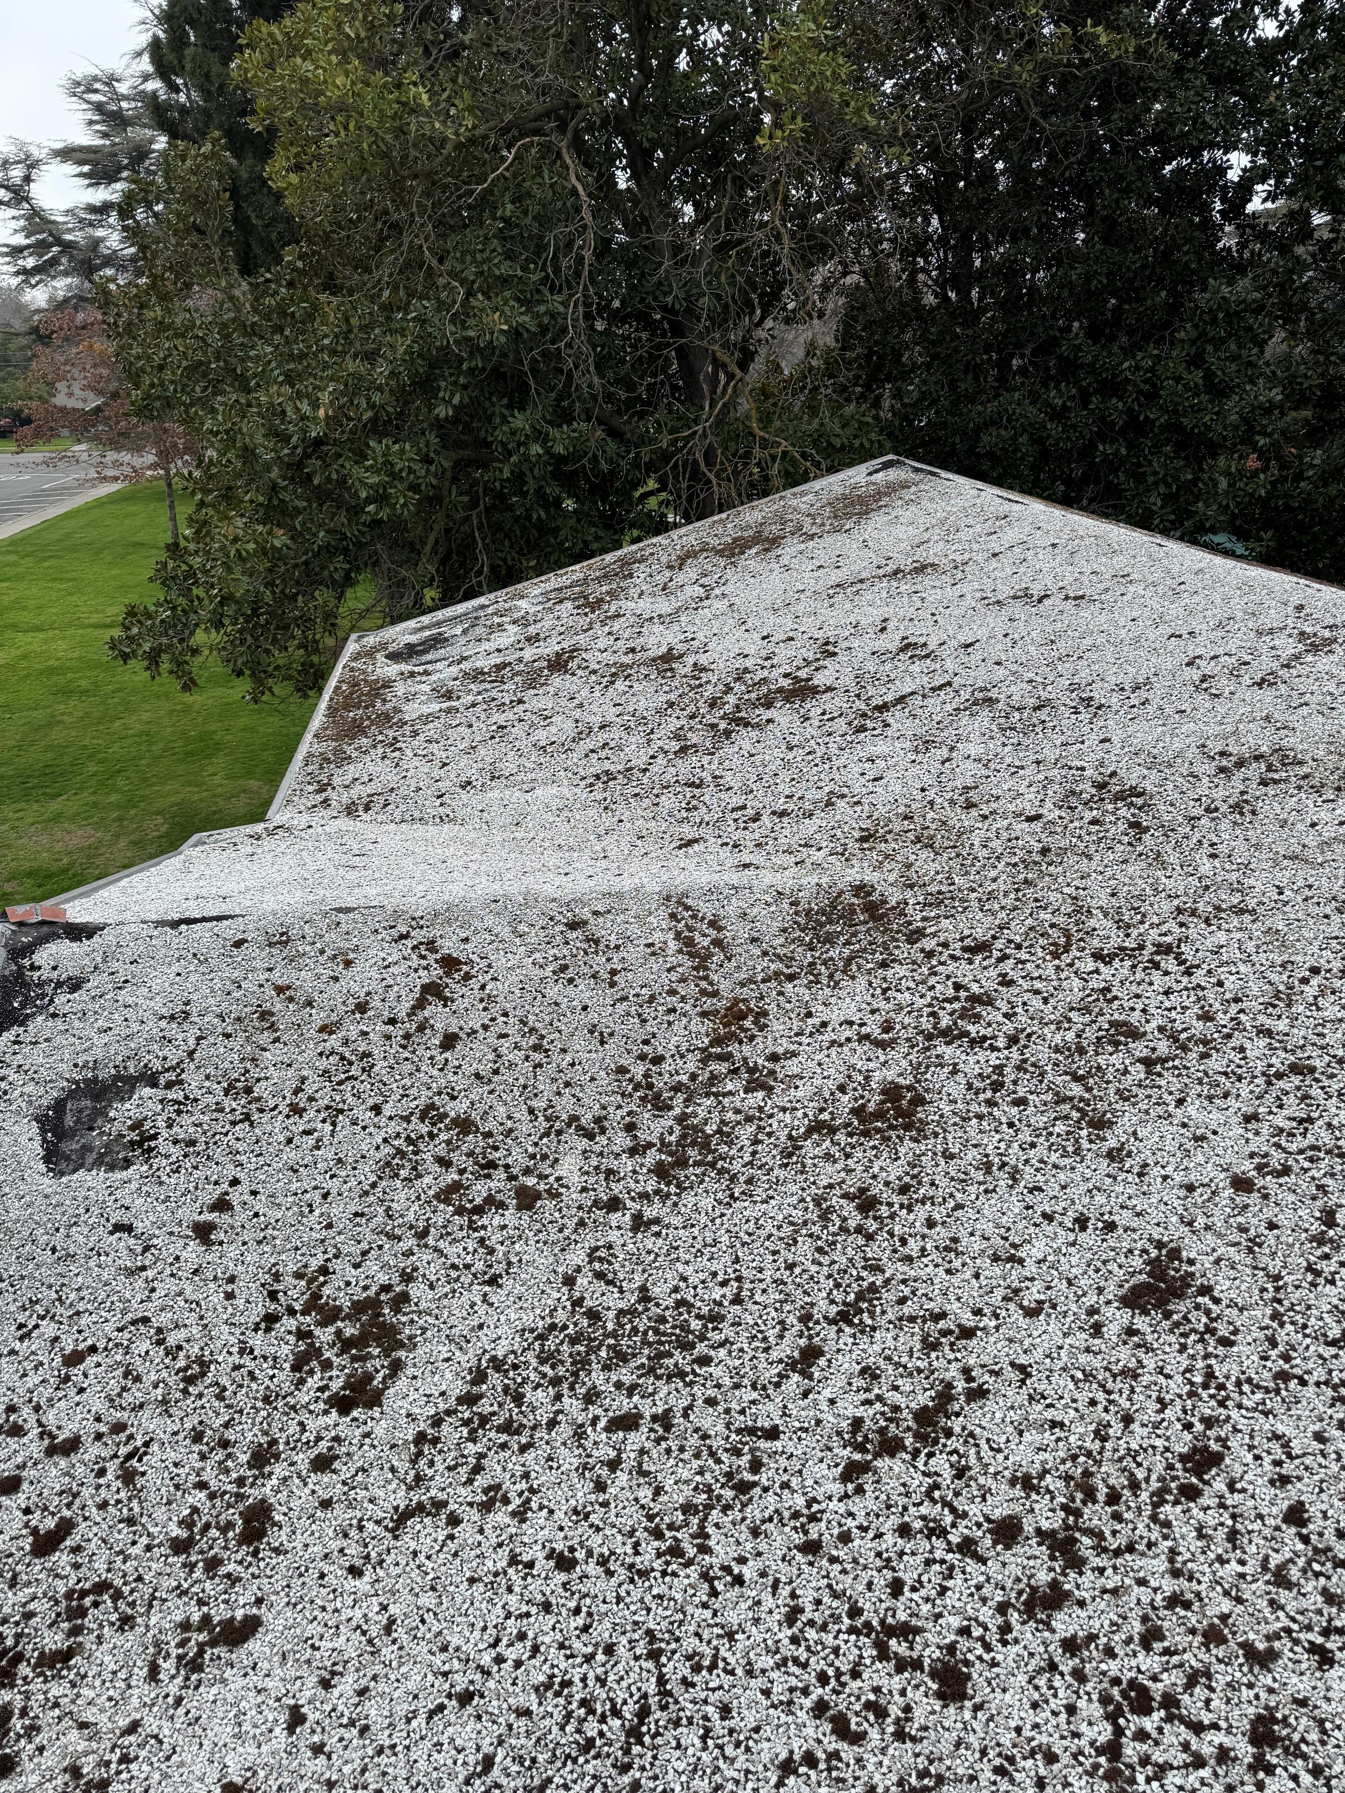
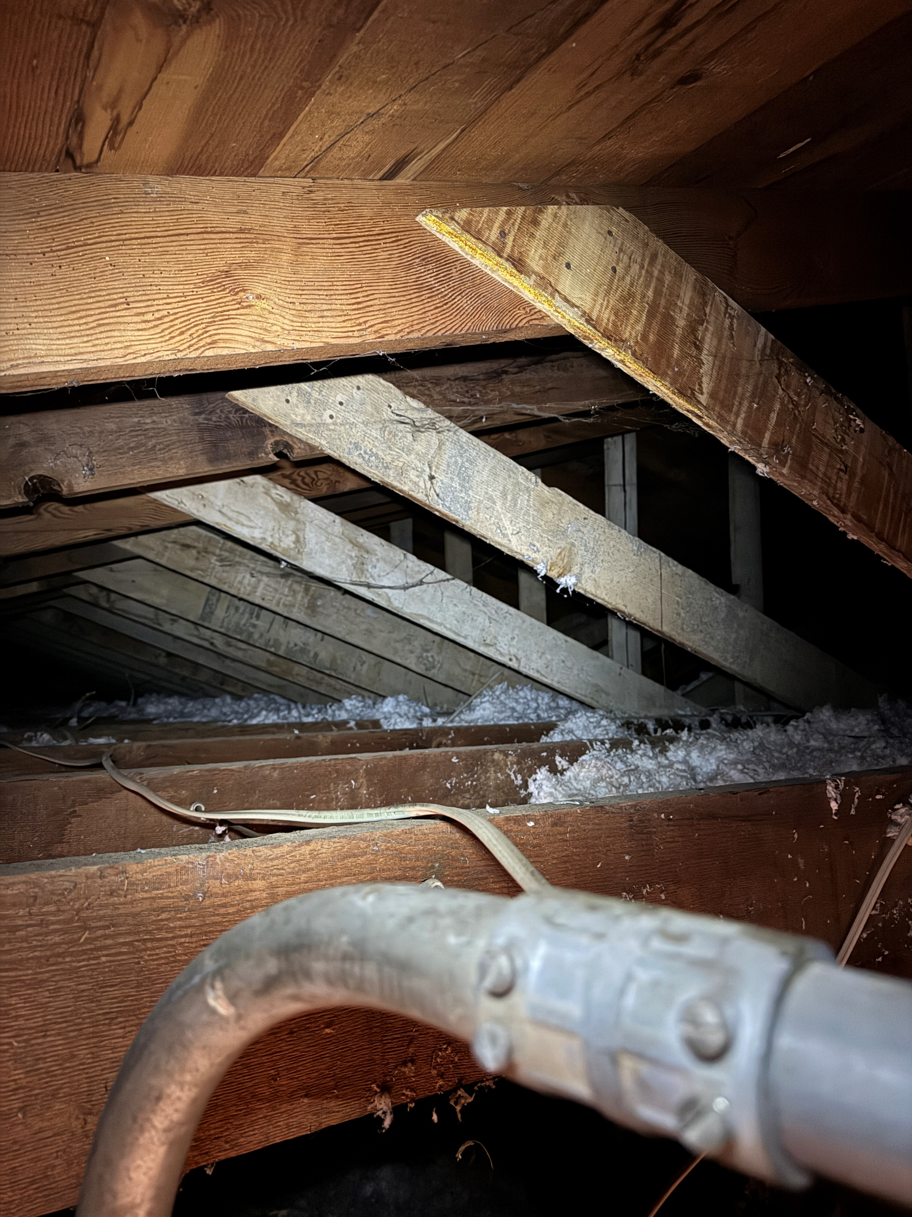
Building Systems - Roof
repair water damaged wood eaves
replace roof and
repair wood trusses
Orland Carnegie Center
April 15, 2025

Slide 8
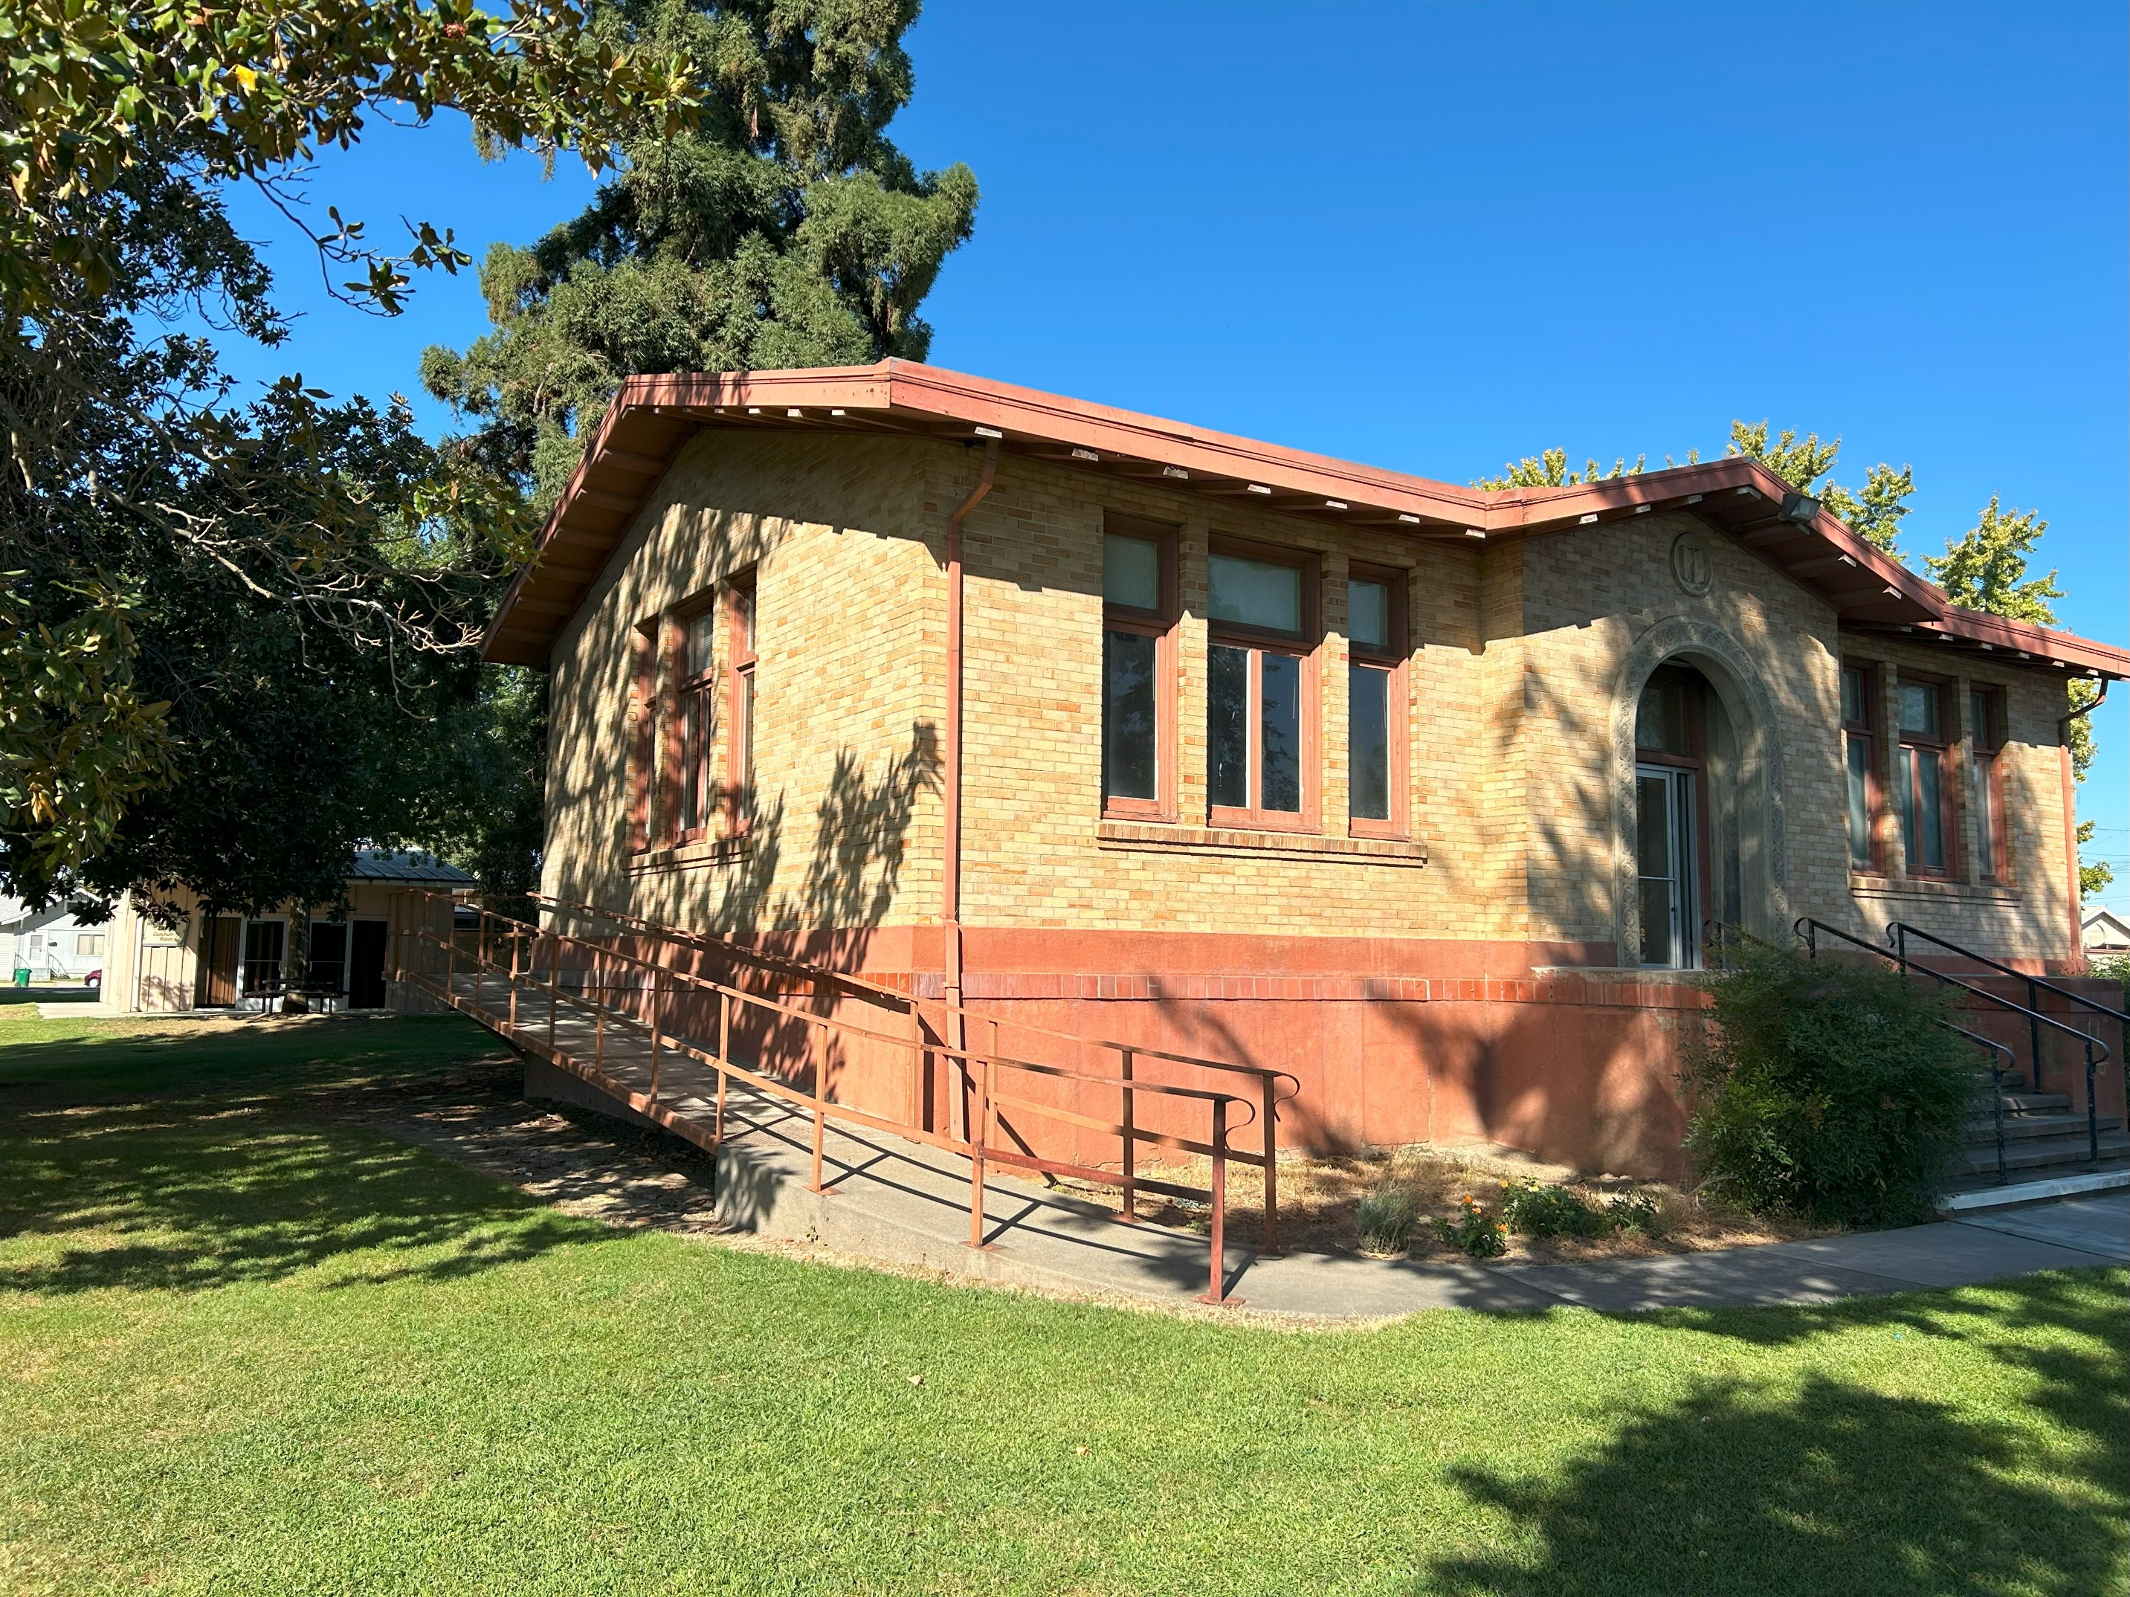
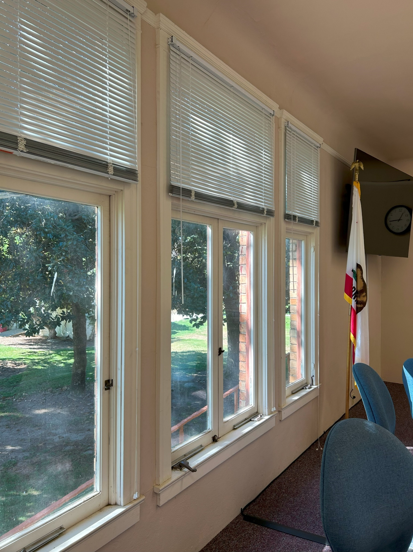
Building Systems - Envelope
Restore wood sash windows with code compliant glazing
Repoint brick masonry
Optional return of basement clerestory
windows
Orland Carnegie Center
April 15, 2025

Slide 9
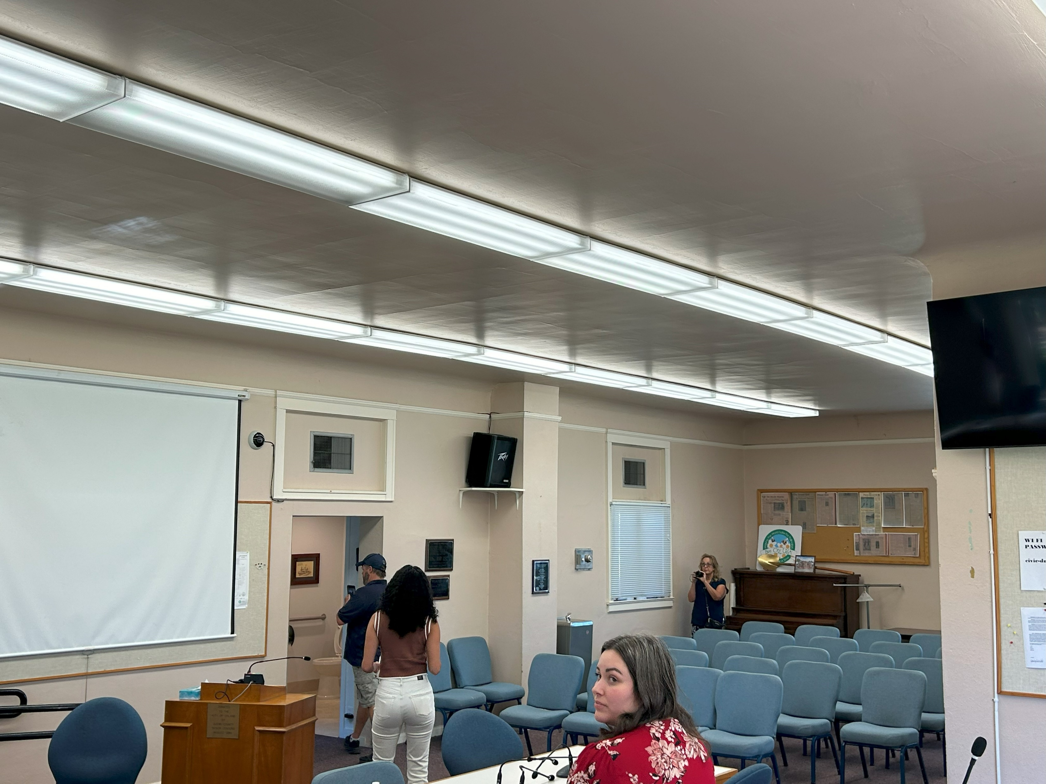
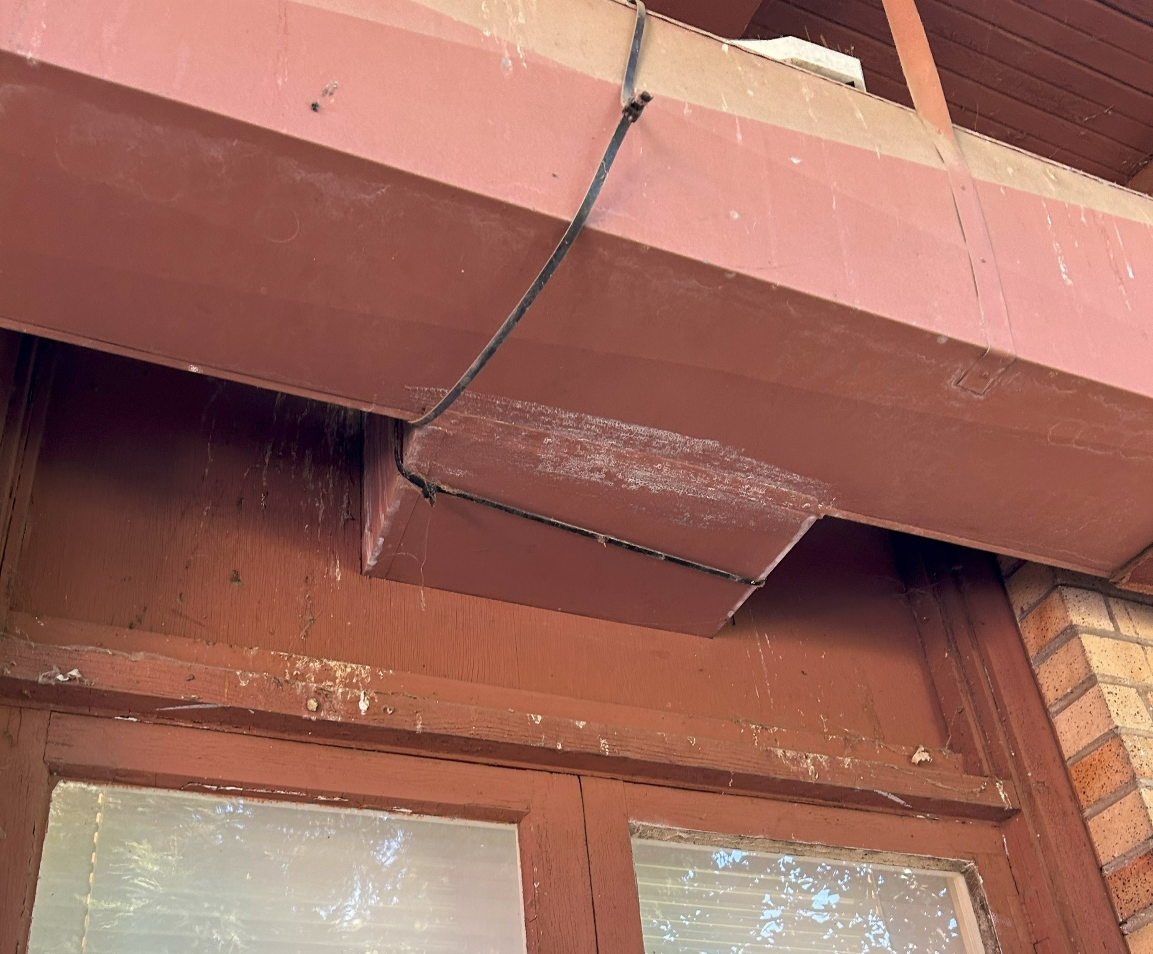
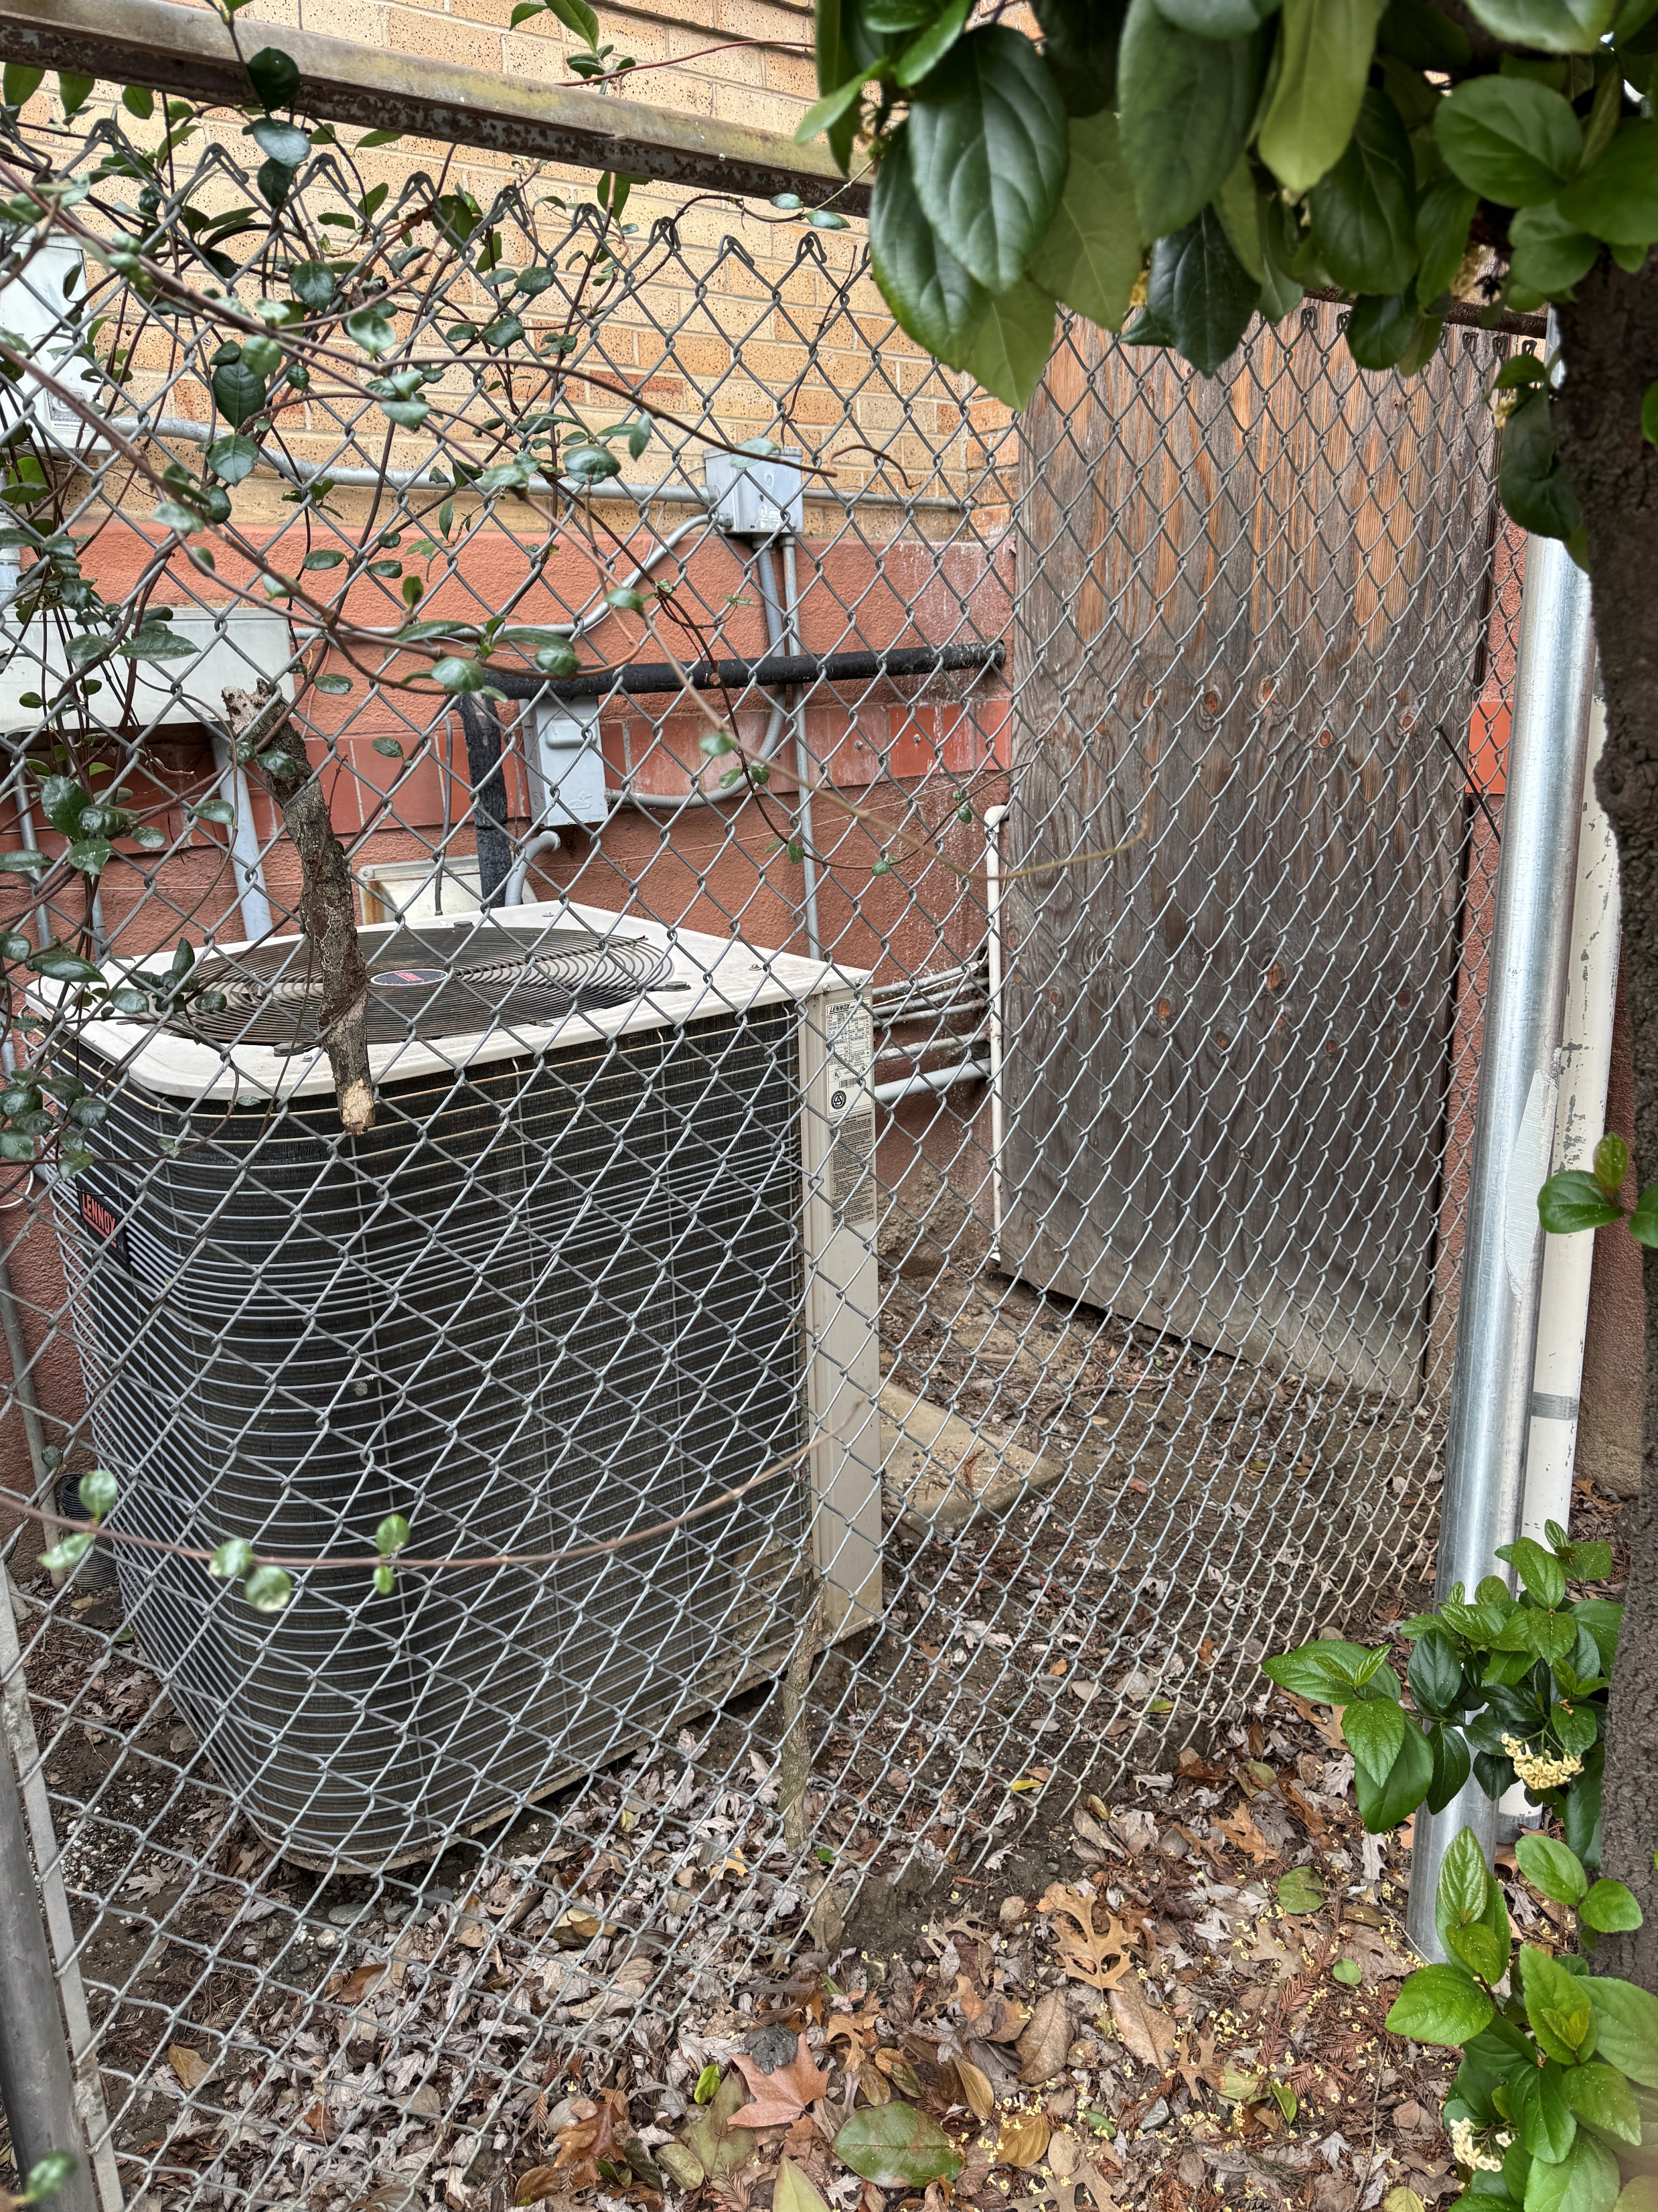
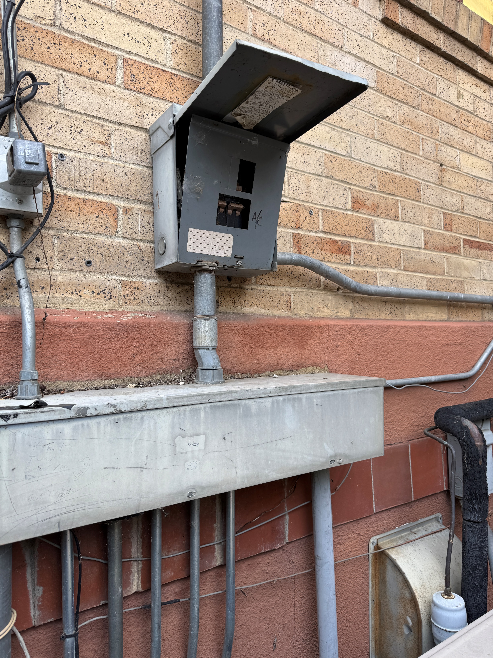
Replace aged-out
equipment
Building Systems - Services
Restore clerestory
New efficient
All electric
Ductless
HVAC system
electrical safety and efficieny upgrades
update lighting
Orland Carnegie Center
April 15, 2025

Slide 10
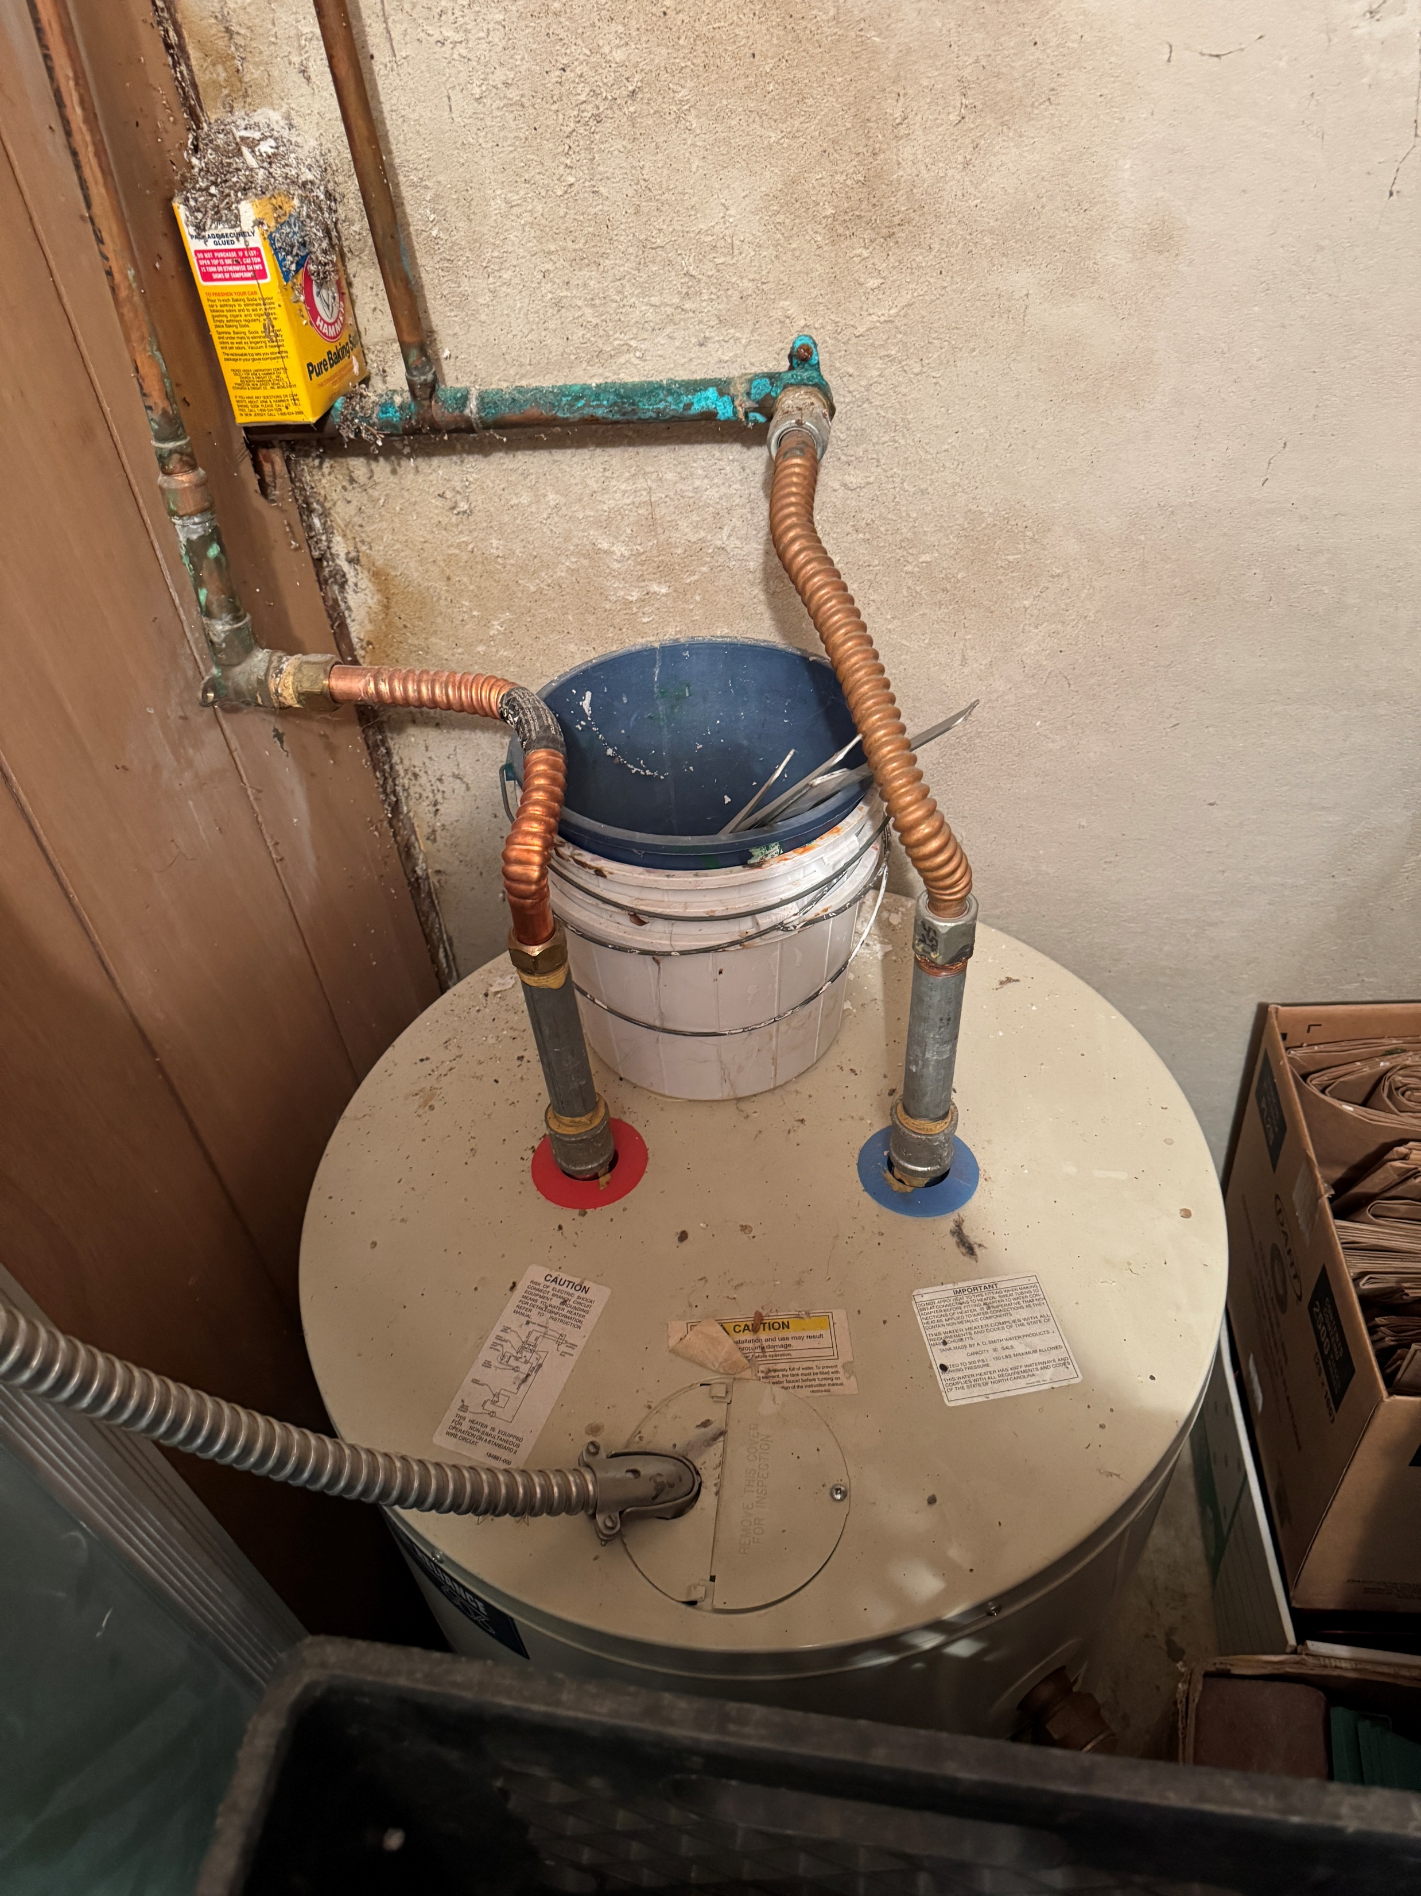
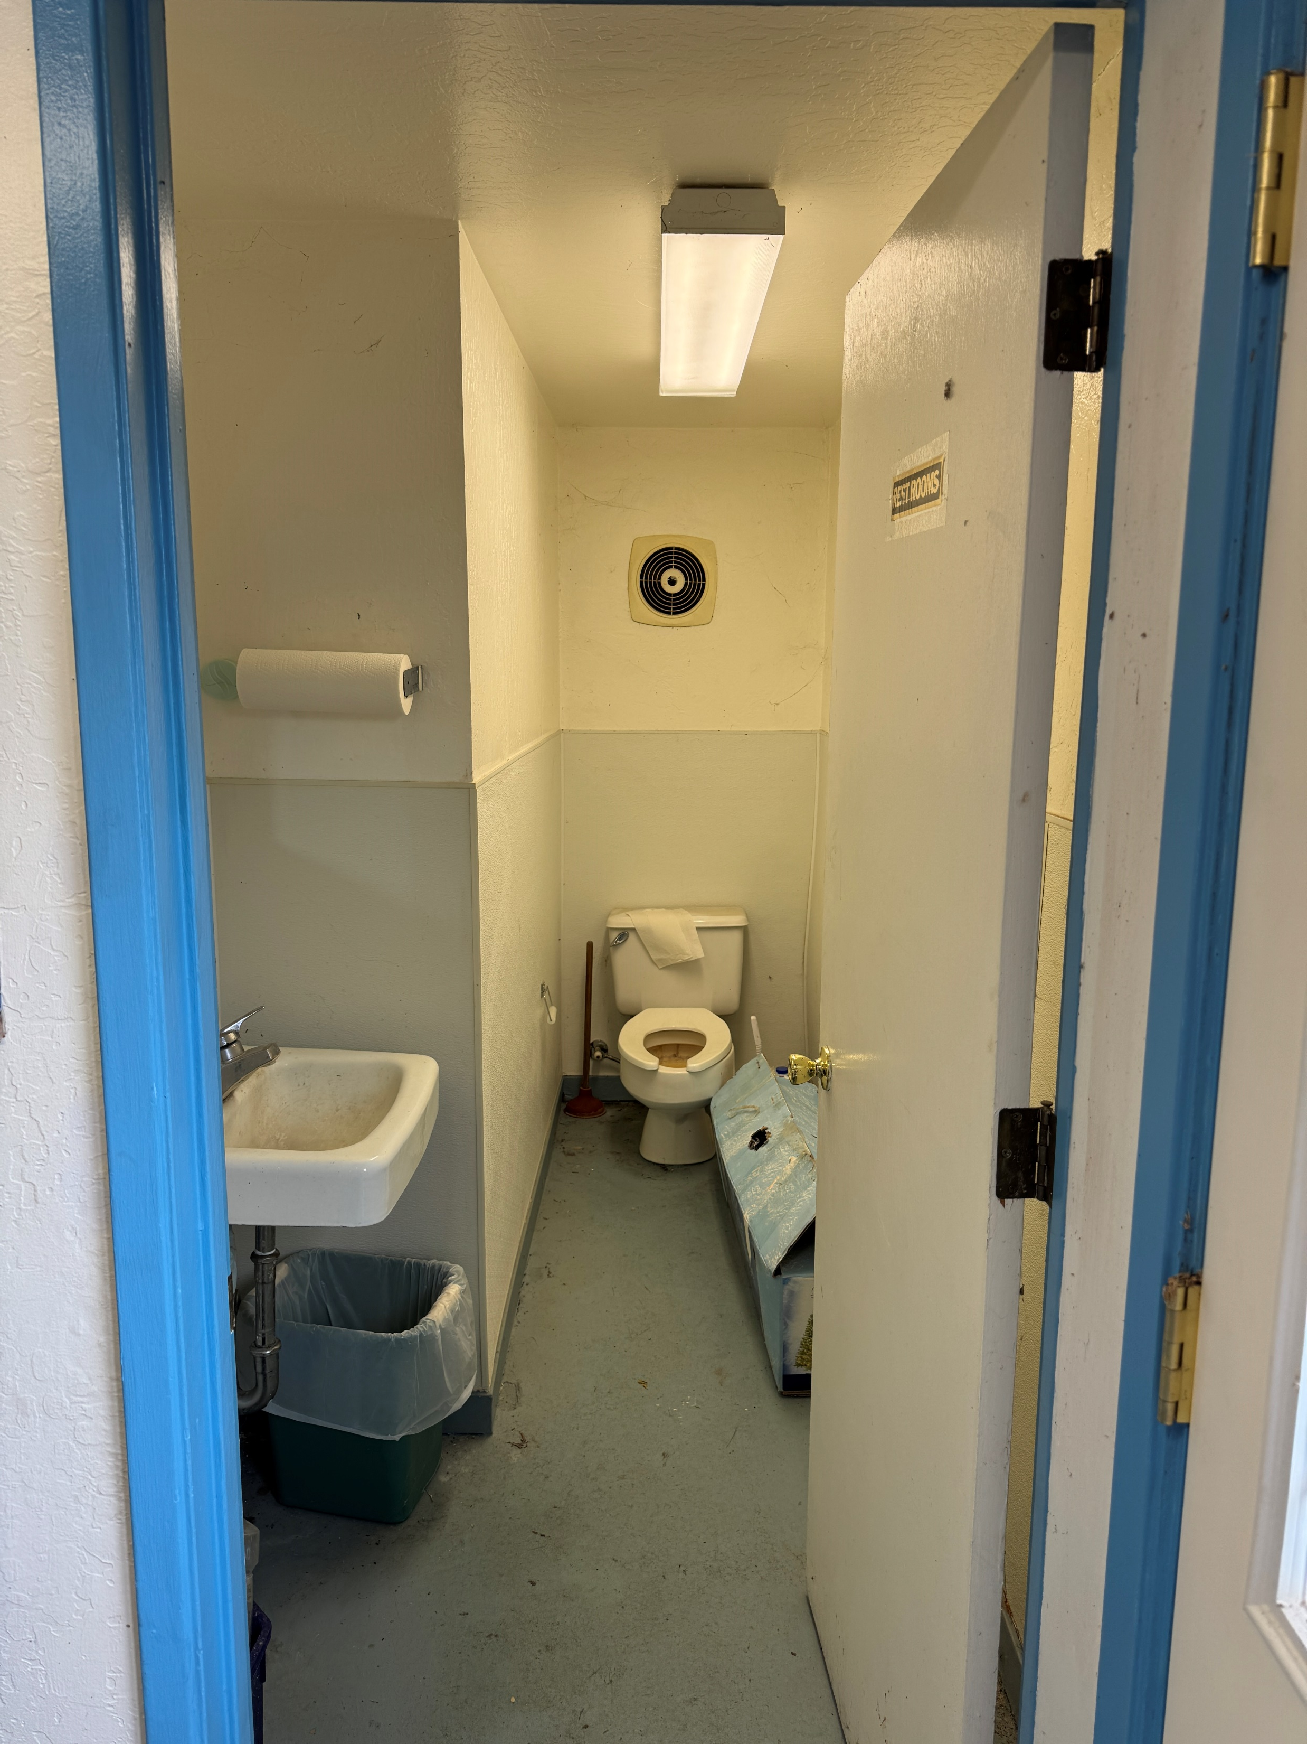
Building Systems - Services
Replace aged-out
equipment with
energy efficient
components
address ALL building related
Accessibility issues
Orland Carnegie Center
April 15, 2025

Slide 11
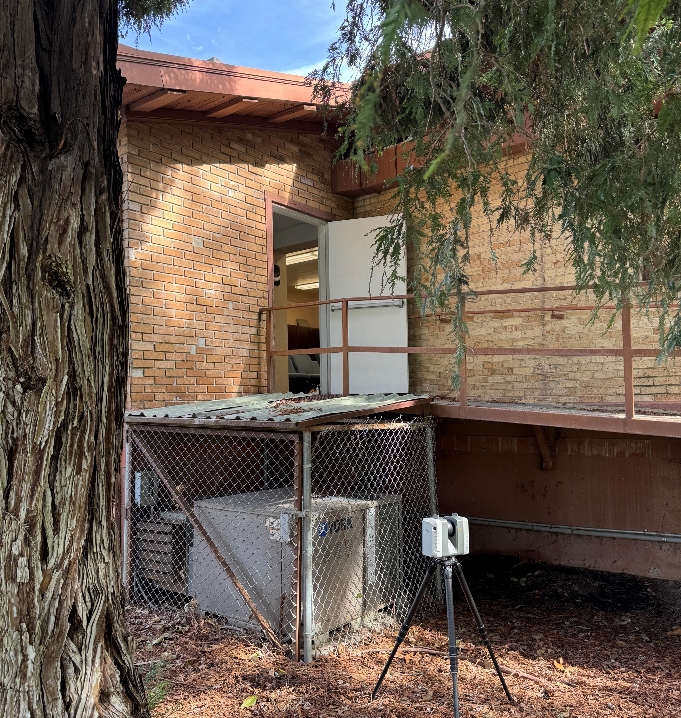
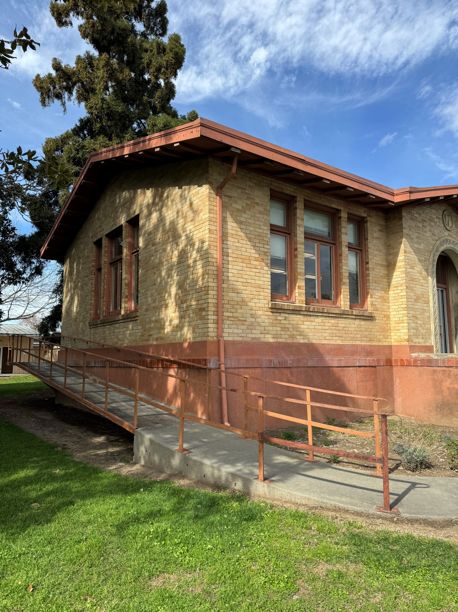
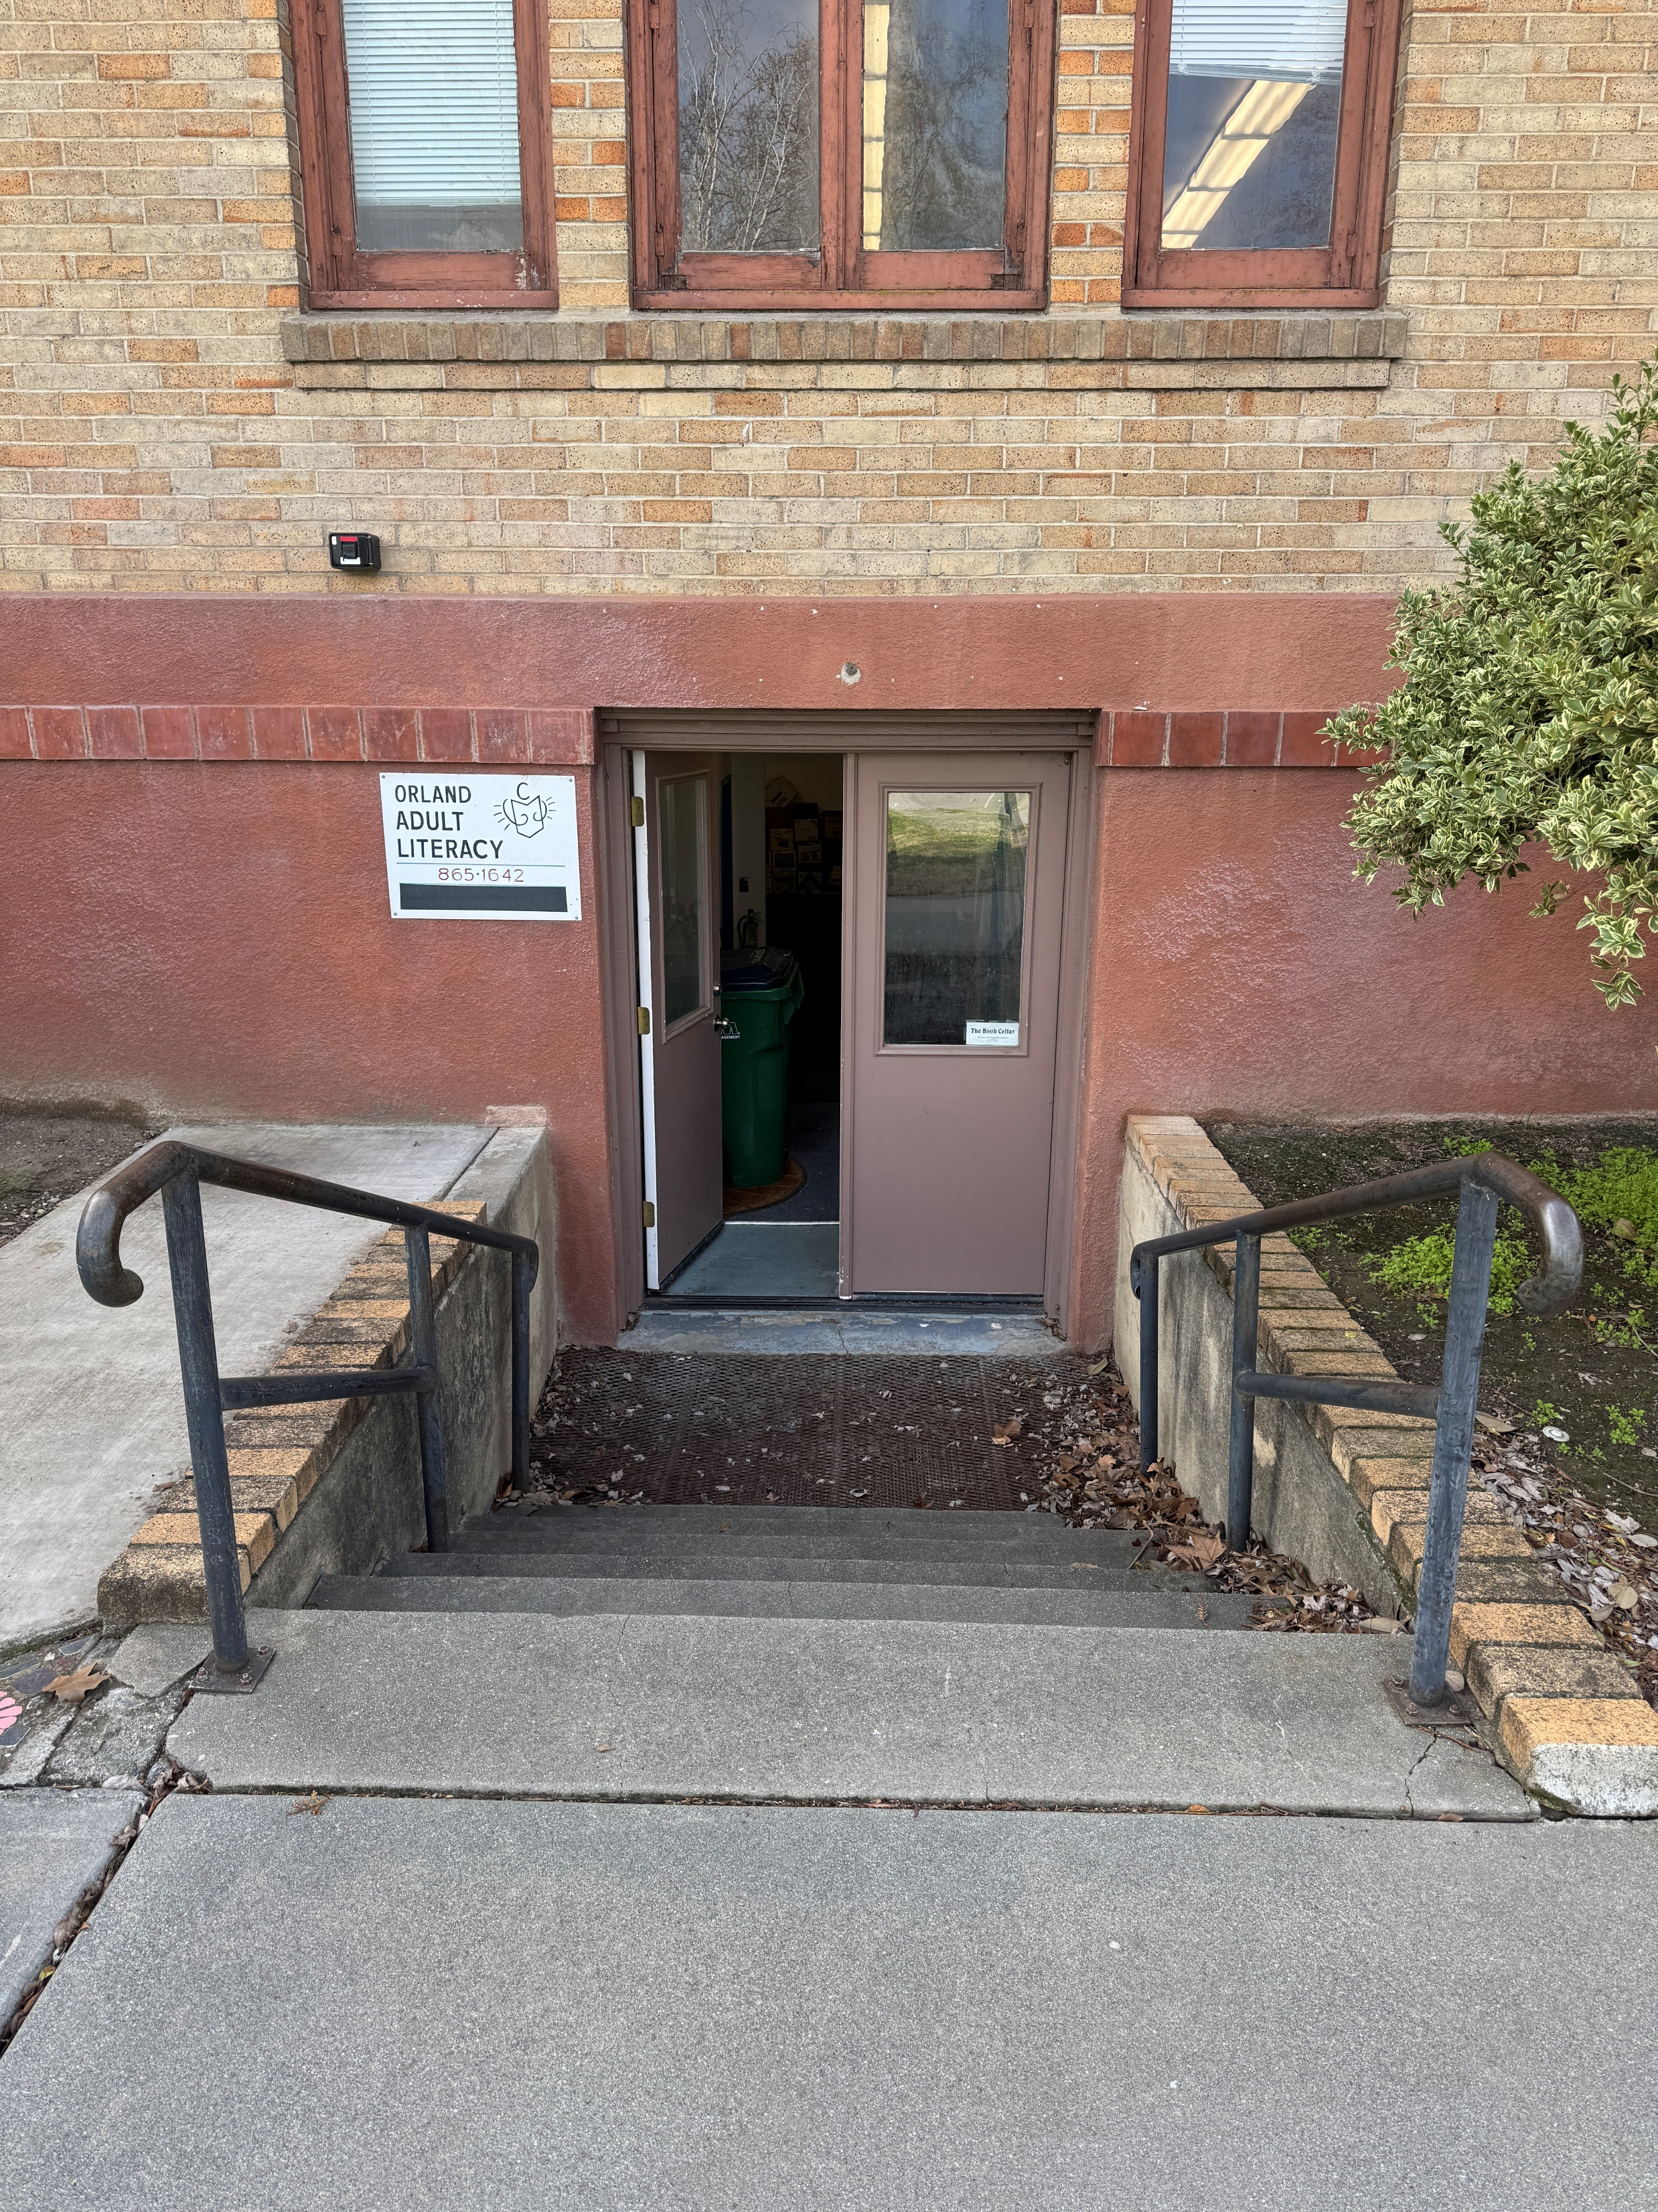
Building Systems – Accessible Access
replace / remove
Aged-out equipment
remove this ramp
which disrupts
original architecture
provide accessible
Access to lower level
Orland Carnegie Center
April 15, 2025

Slide 12
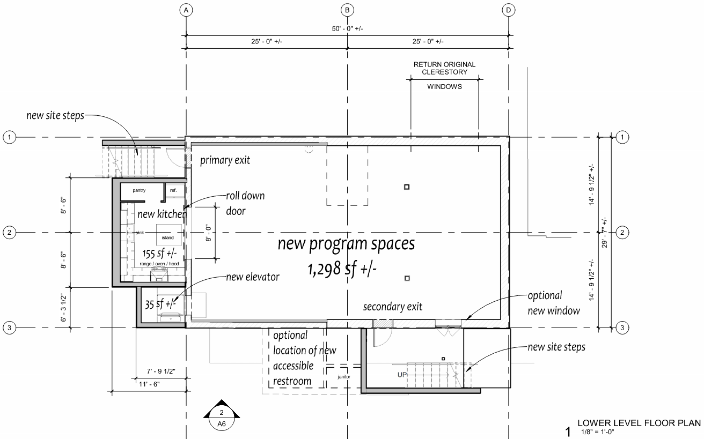
Orland Carnegie Center
April 15, 2025

Slide 13
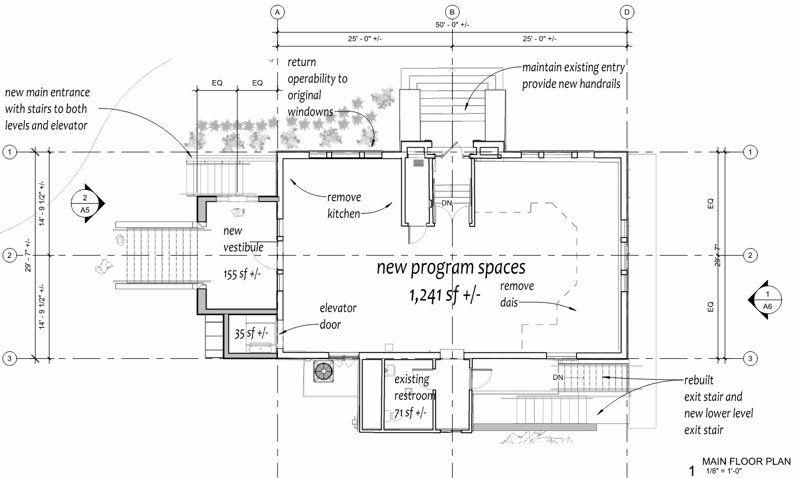
Orland Carnegie Center
April 15, 2025

Slide 14
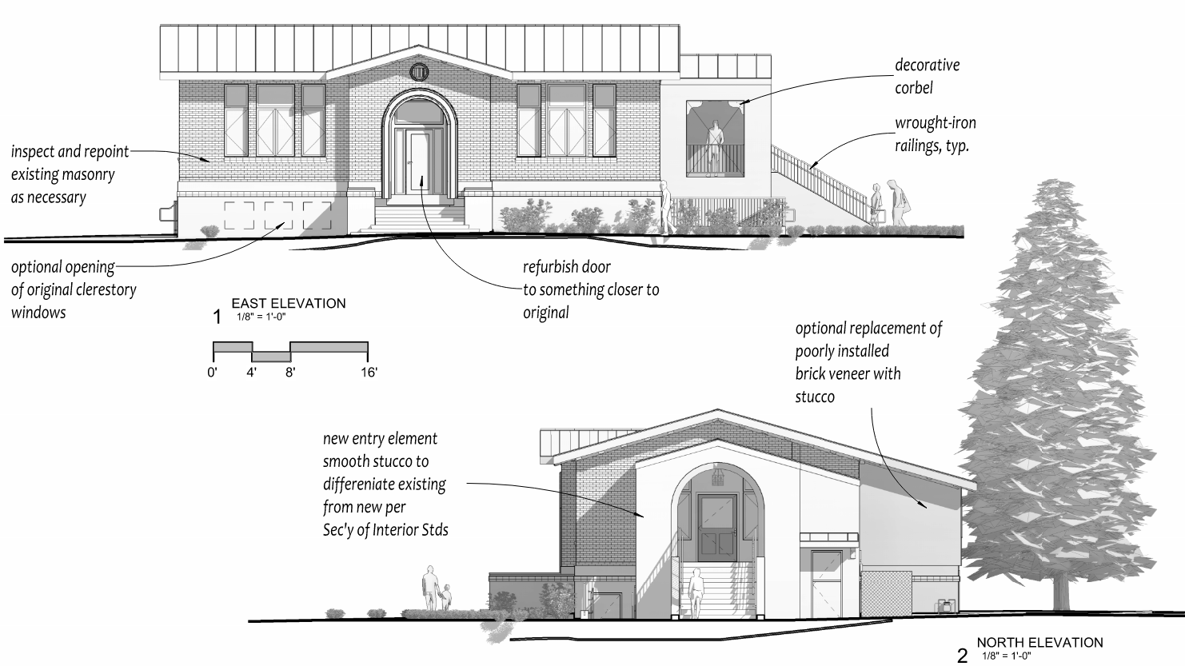
Orland Carnegie Center
April 15, 2025

Slide 15
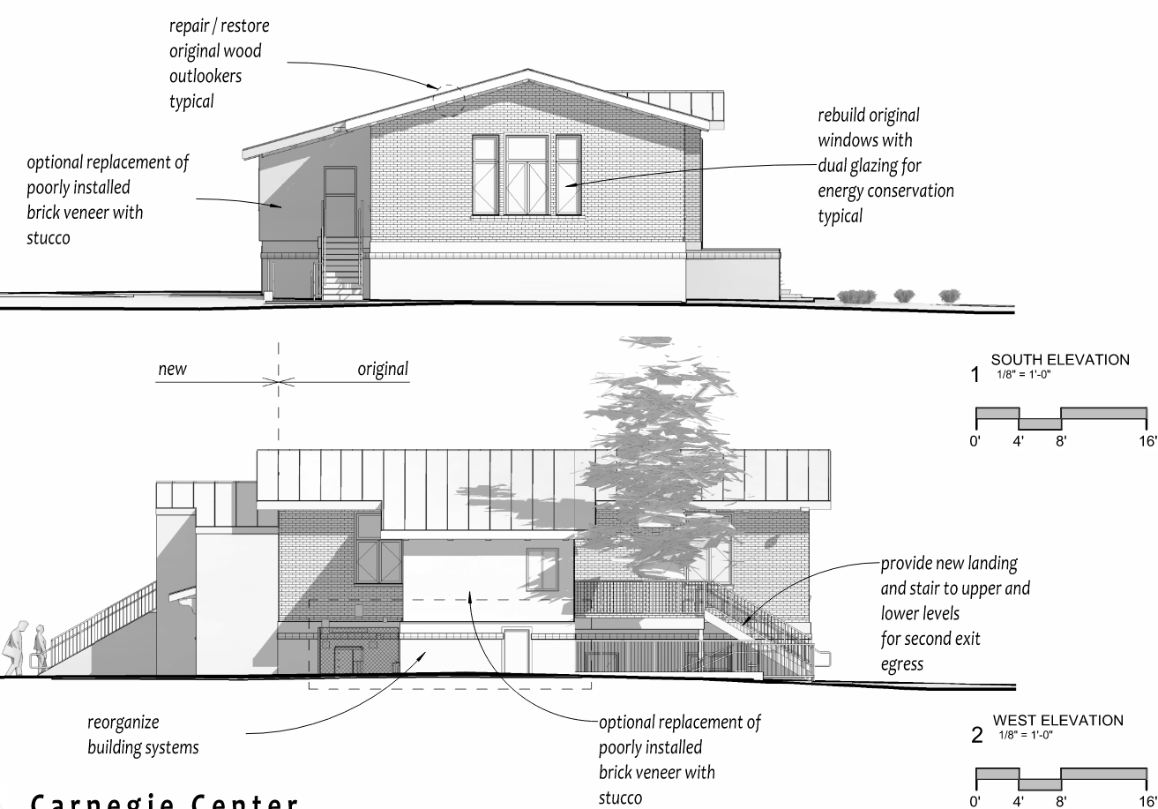
Orland Carnegie Center
April 15, 2025

Slide 16
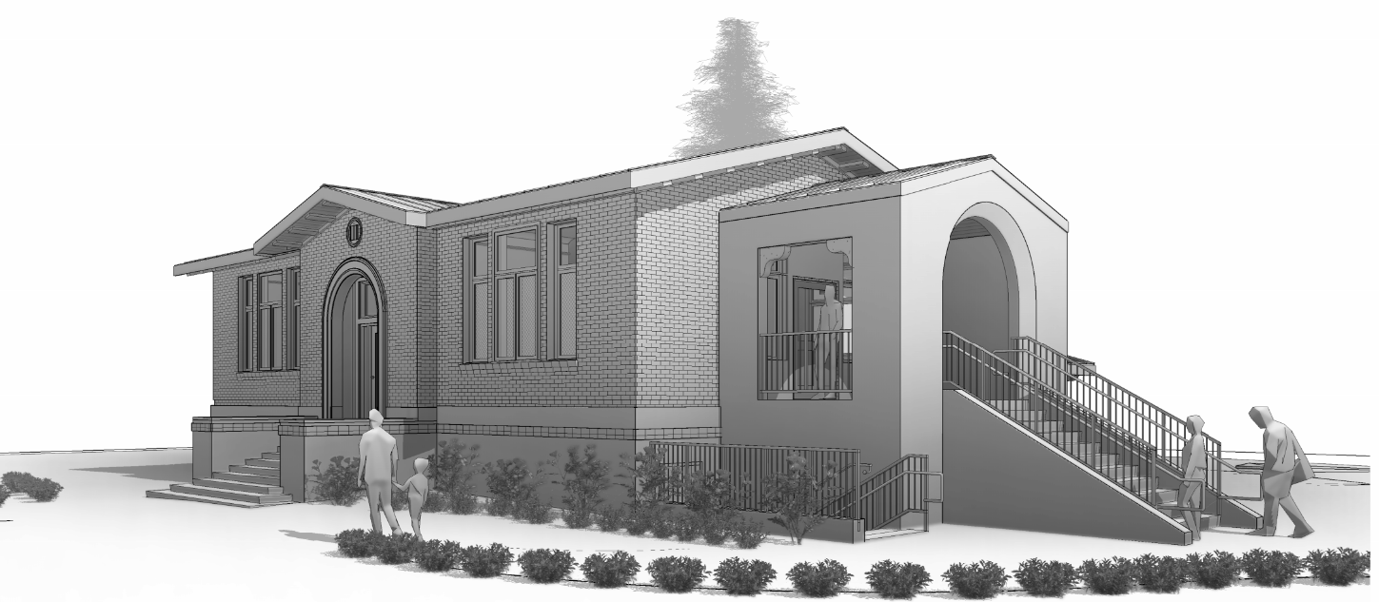
Orland Carnegie Center
April 15, 2025

Slide 17
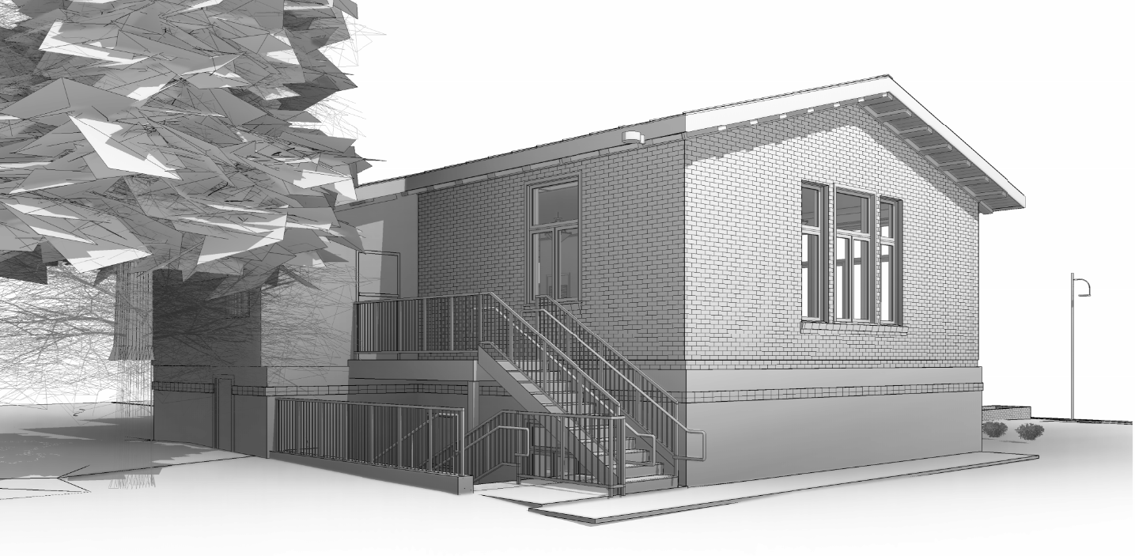
Orland Carnegie Center
April 15, 2025

Slide 18
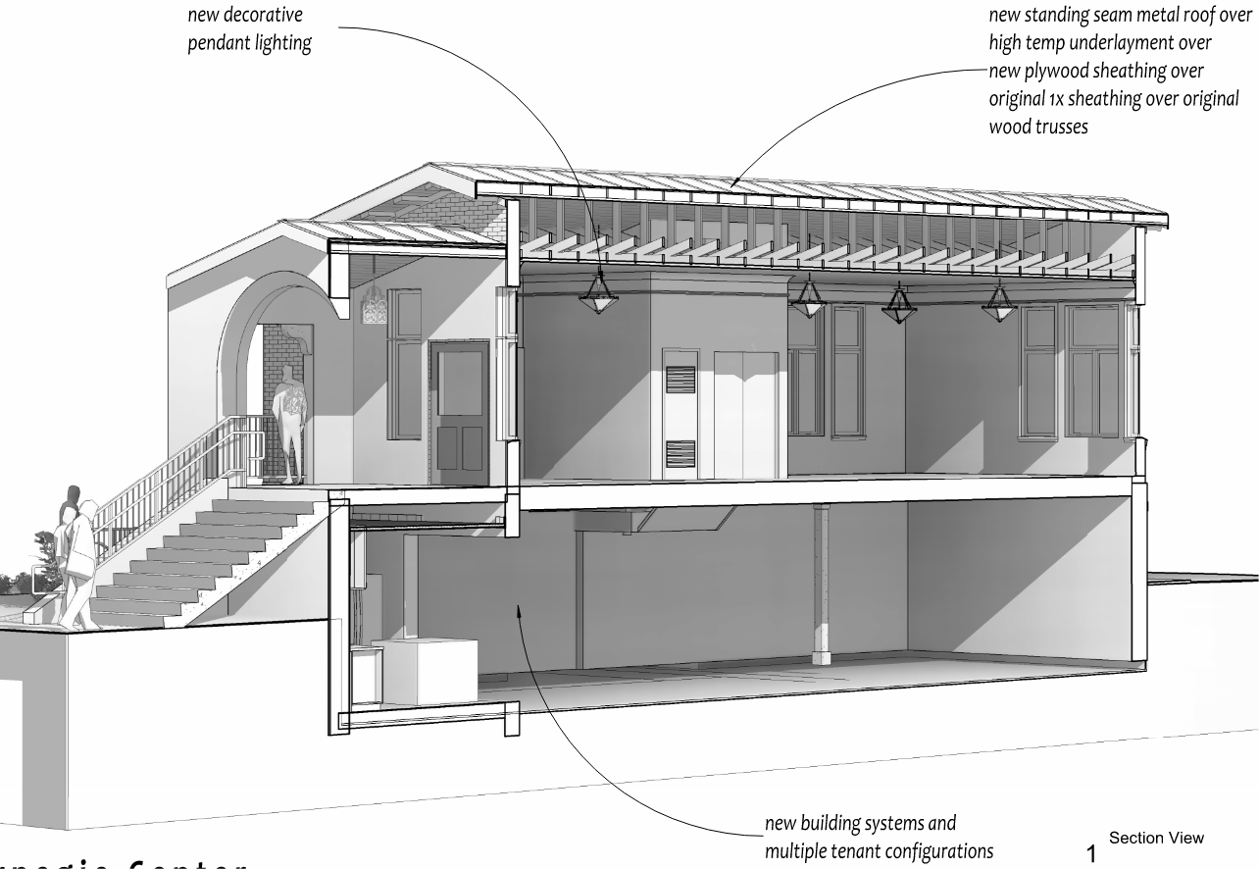
Orland Carnegie Center
April 15, 2025

Slide 20
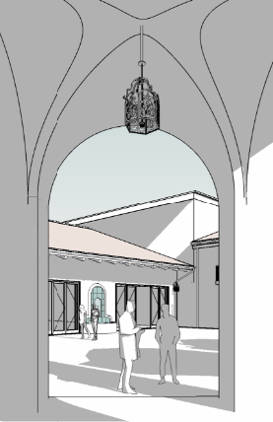
Orland City Facilities along Mill Street
A quick charette to study the possibility of upgrading City facilities along Mill Street was undertaken.
The goal of the study was to imagine a future development that could both address programmatic / spatial needs of City functions while addressing current blight in an elegant manner echoing and perhaps eestablishing historic precedents.
The following images are presented for your consideration as a possible direction.
Orland City Hall
April 15, 2025

Slide 21
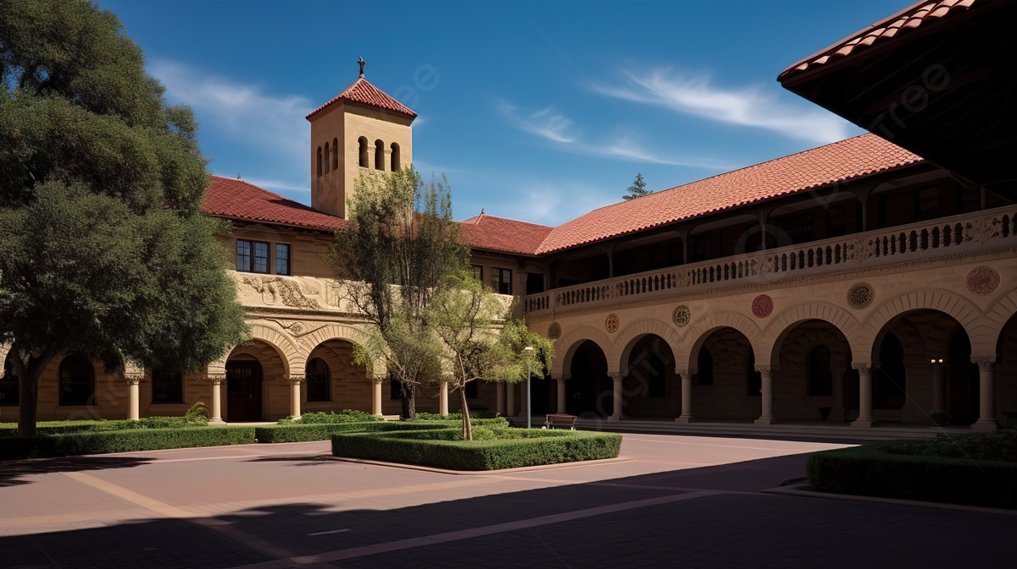
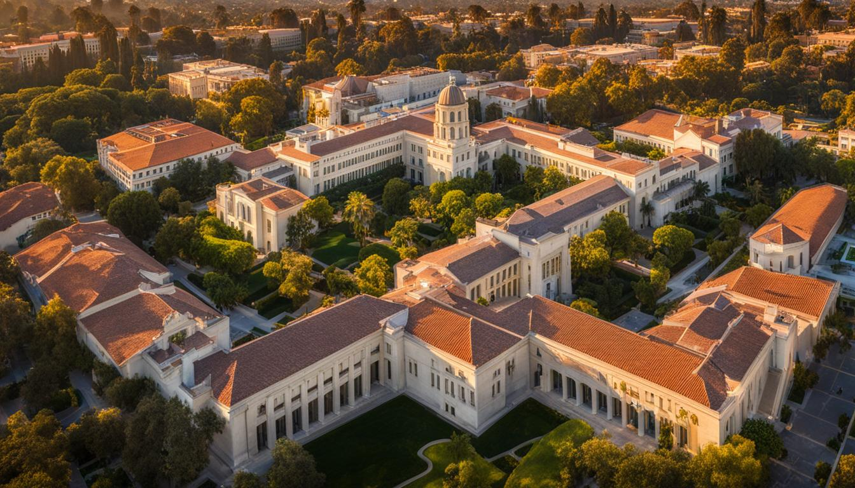
Early California Precedents
CalTECH
Stanford University
Orland City Hall
April 15, 2025

Slide 22
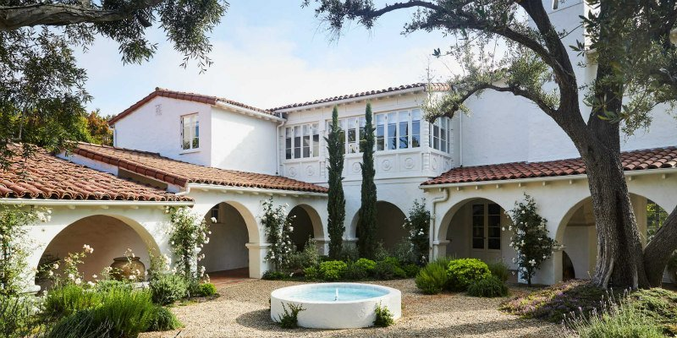
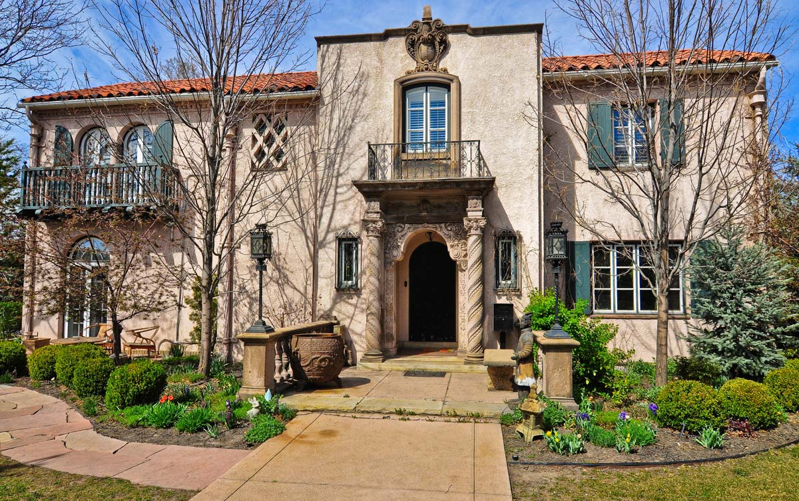
Early California Precedents
Spanish Colonial – Residential Examples
Orland City Hall
April 15, 2025

Slide 23
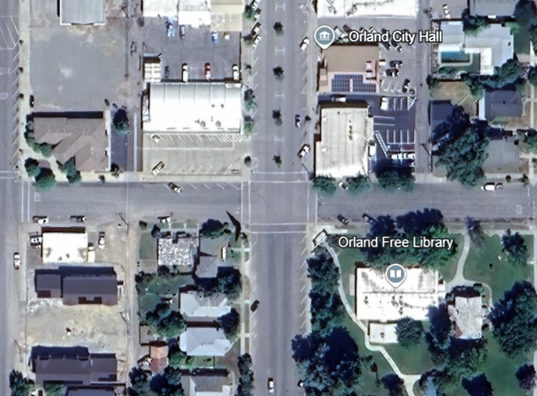
Context
PD
Facade
City Hall Square
Mill Street
ROW
Improvements
City Cultural Center / Gym

Slide 24
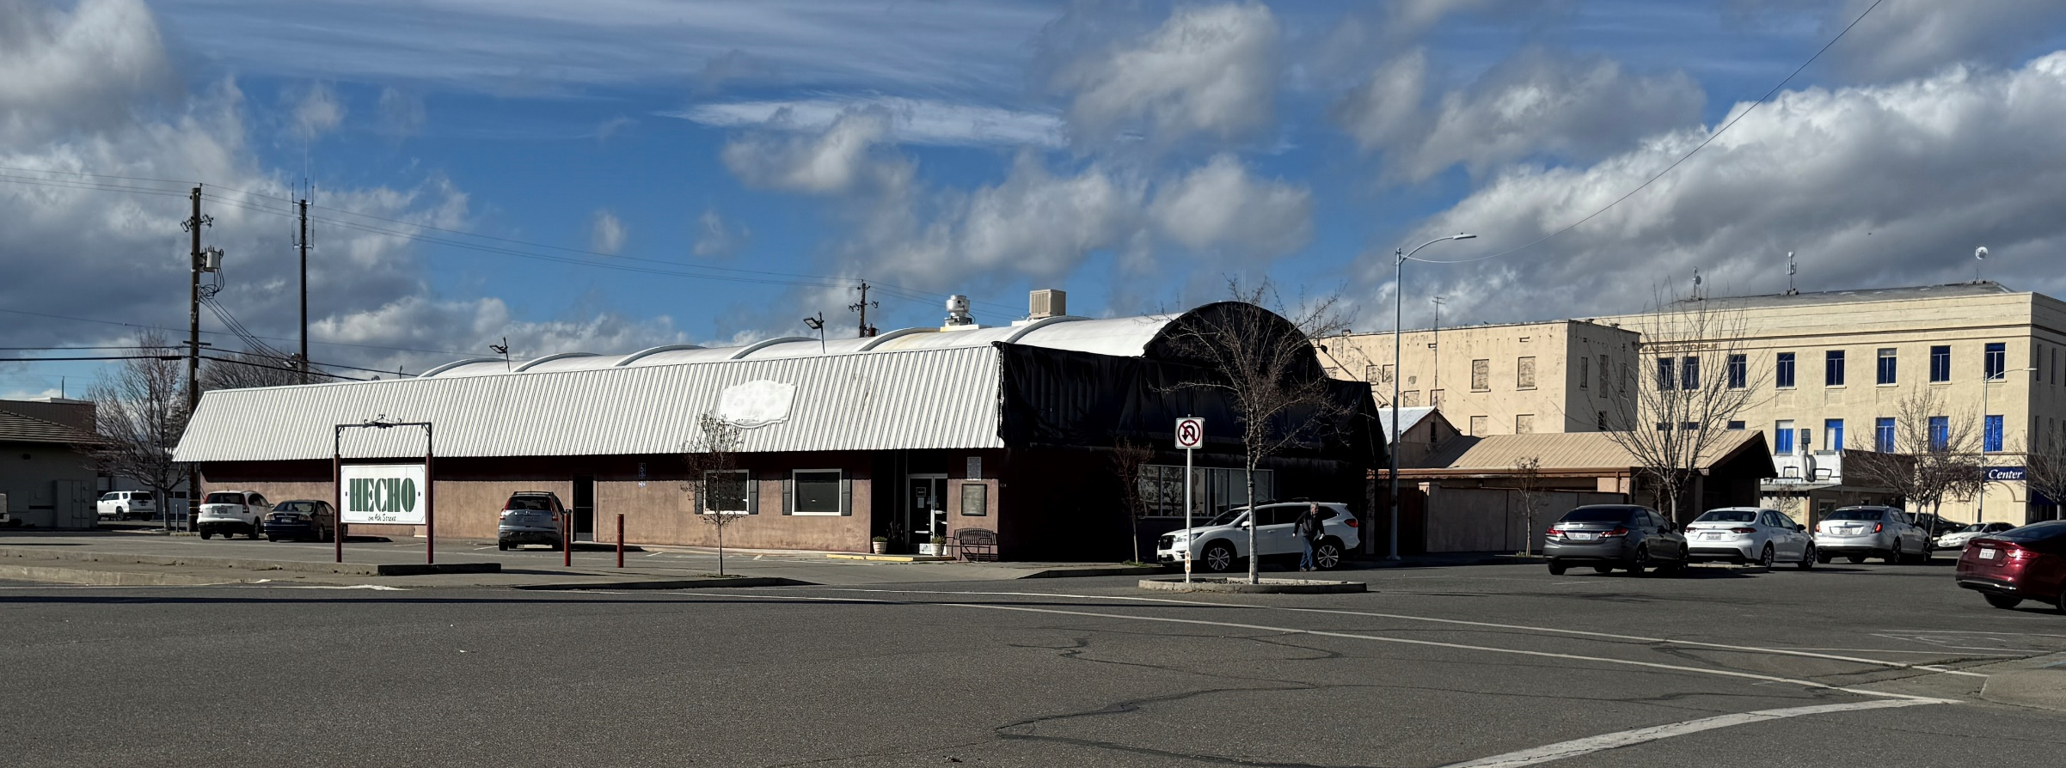
Possible City Hall Lot (130’ x 120’, 15,600 sq ft)
Orland City Hall
April 15, 2025

Slide 25
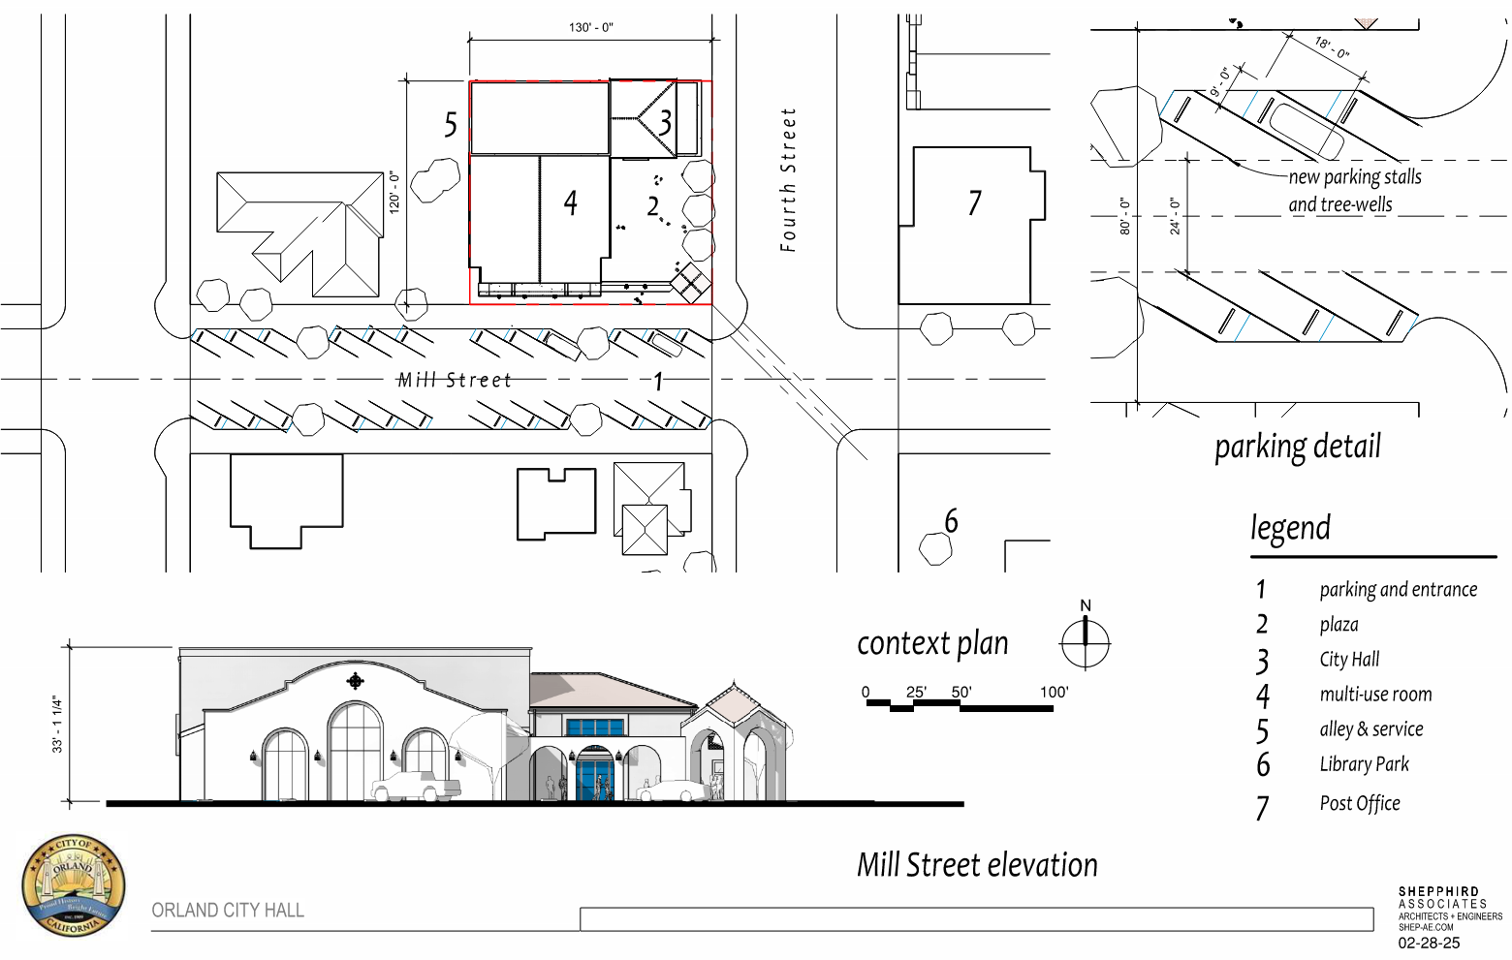
City Hall Square
Mill Street
ROW
Improvements

Slide 26
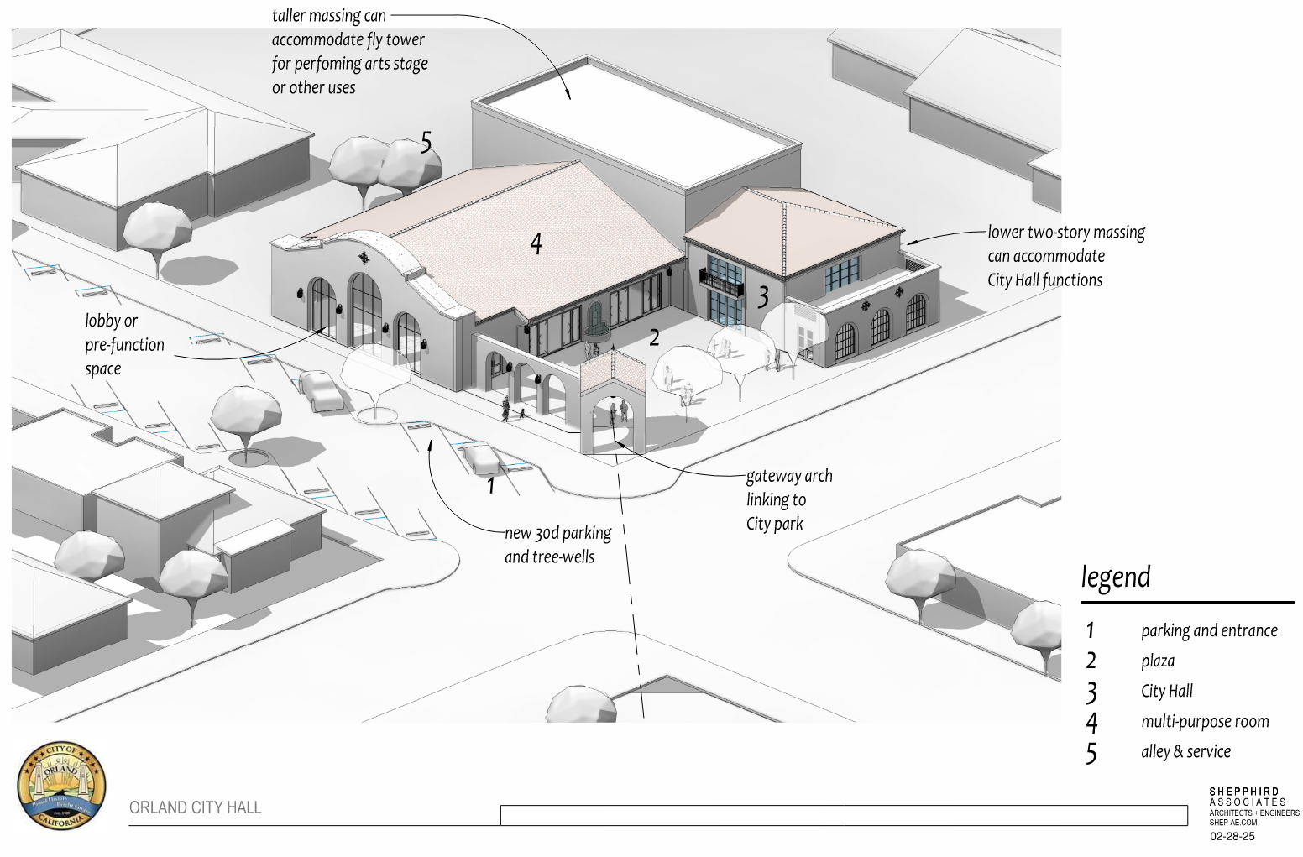
Aerial view

Slide 27
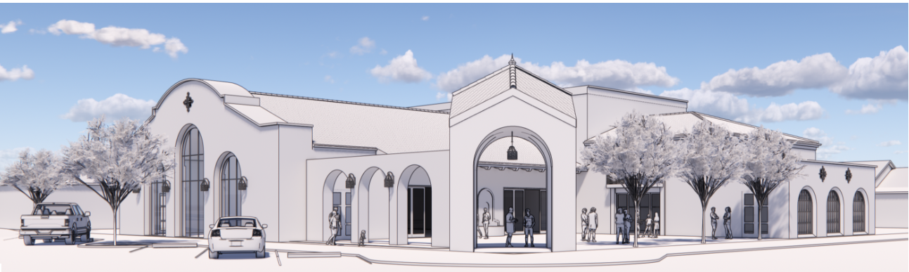
View from Mill Street
Orland City Hall
April 15, 2025

Slide 28
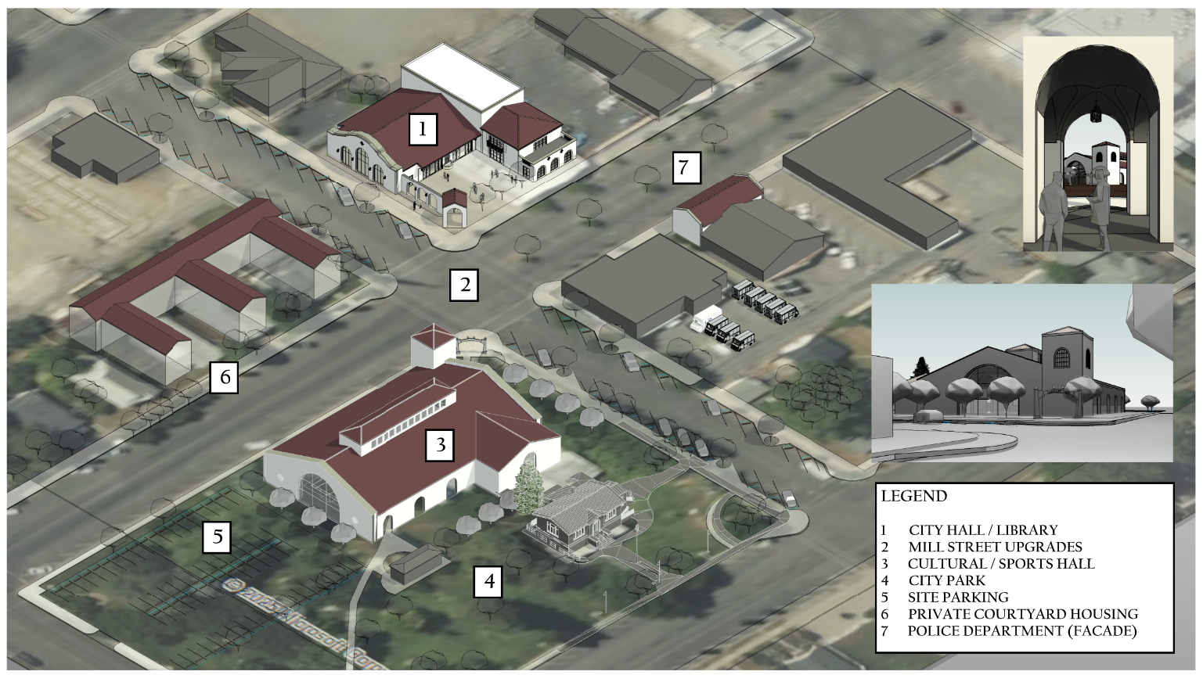
Mill Street Aerial

Slide 29
Mill Street Aerial
City Cultural Center / Gym

Slide 30
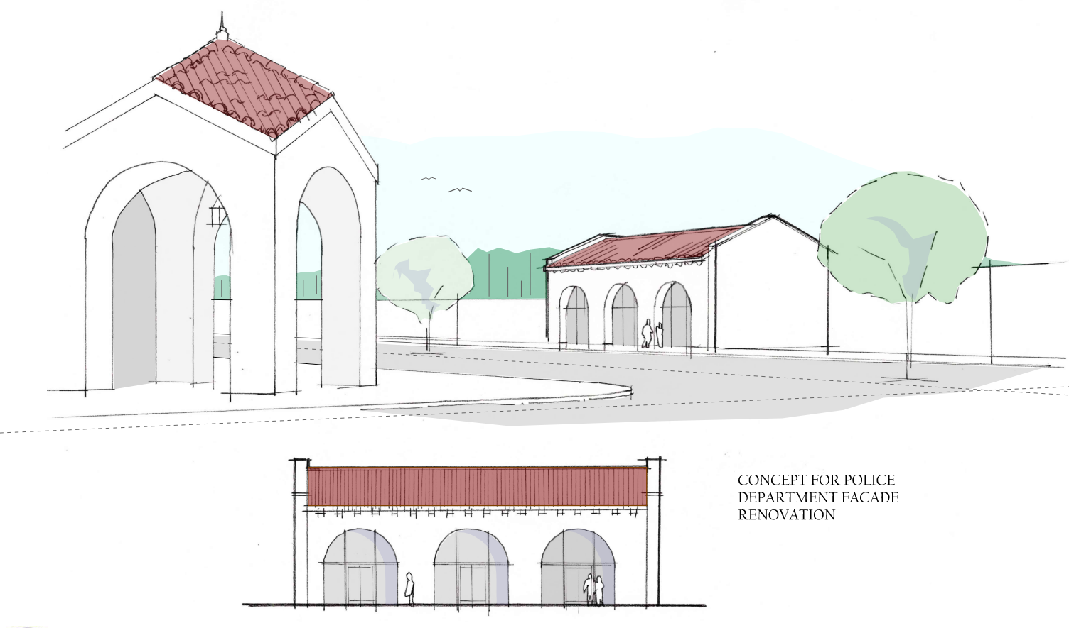
PD
Facade
Orland City Hall
April 15, 2025

