Slide 1
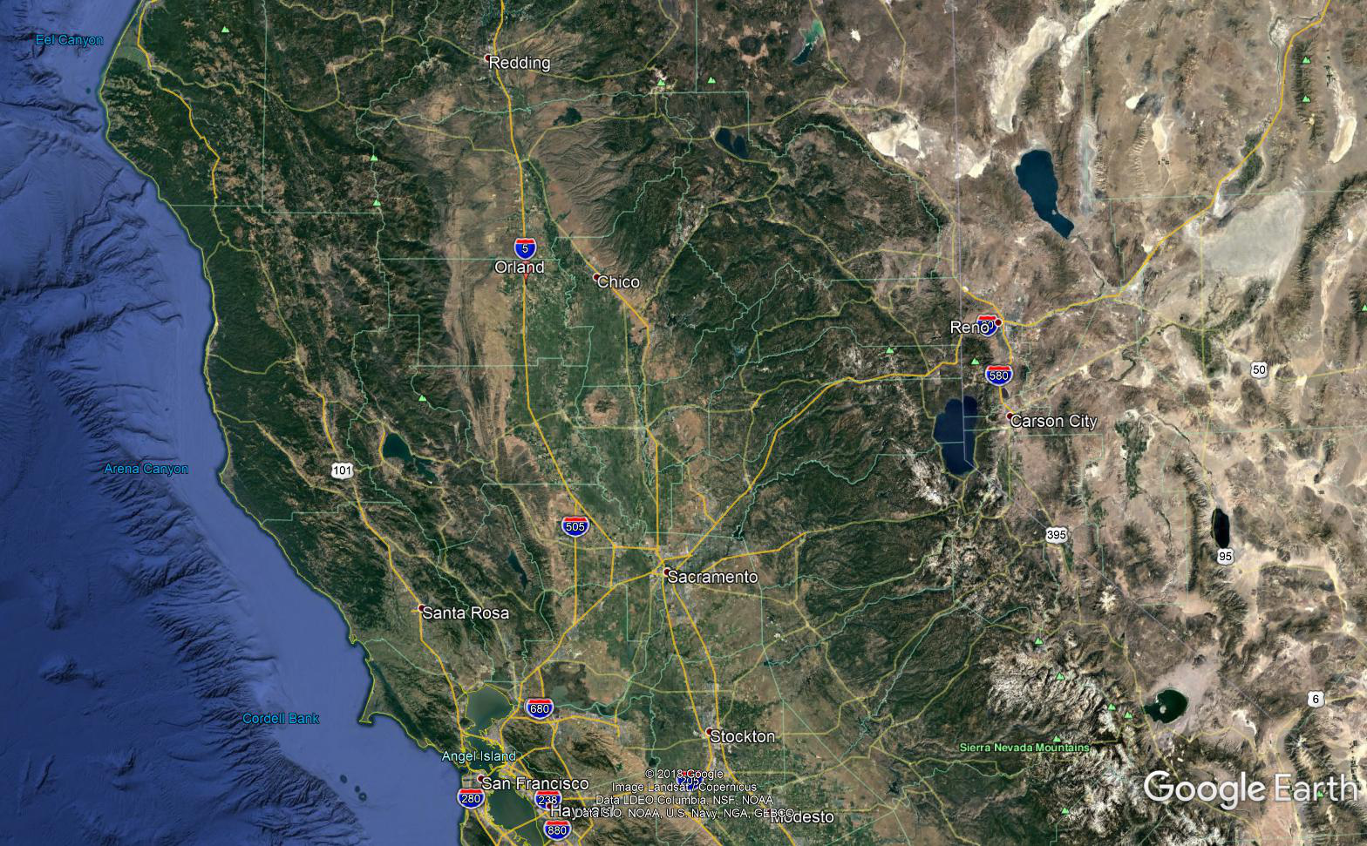
Orland
On I-5 @ SR32 to Chico
2 hrs north of Sacramento
2.5 hrs from SF Bay Area

Slide 2
14,000 pop
Local
35,000 pop
20 minute drive
140,000 pop
30 minute drive

Slide 3
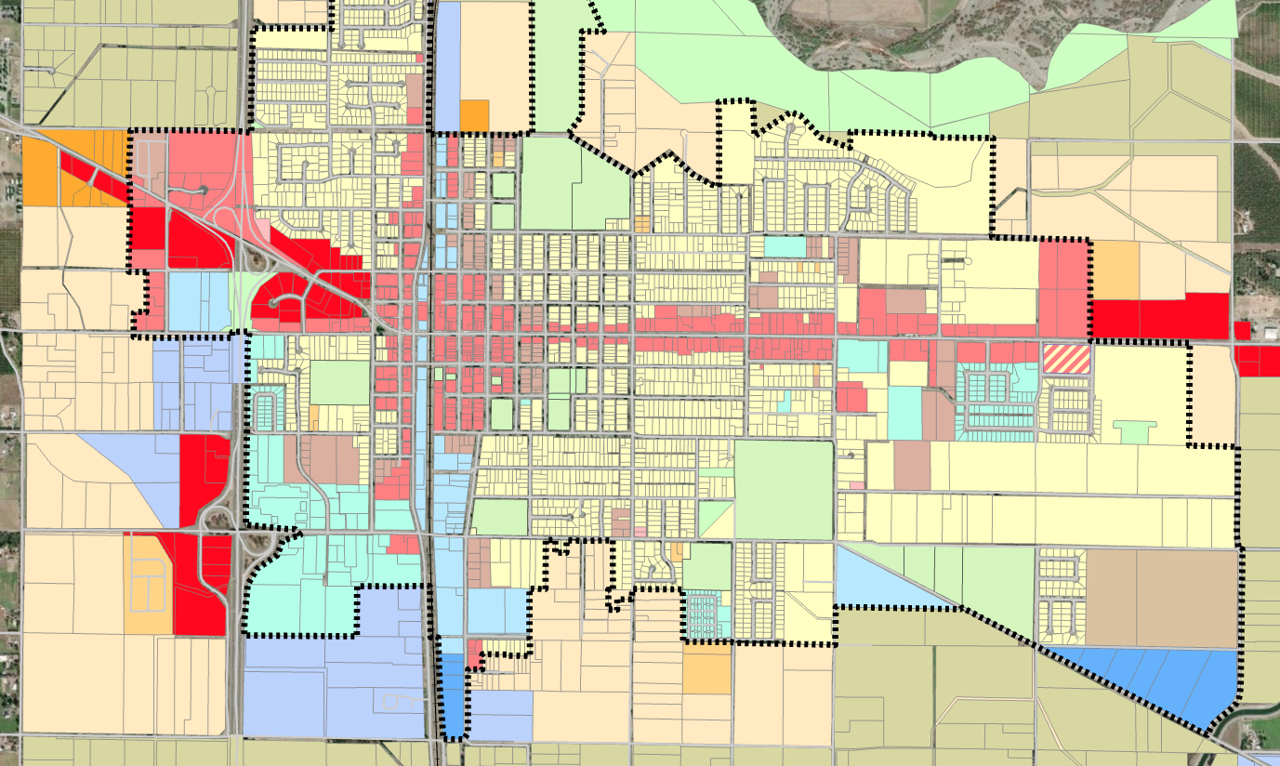
Orland
City Utilities
Pro-business City
Freeway & Rail access

Slide 4
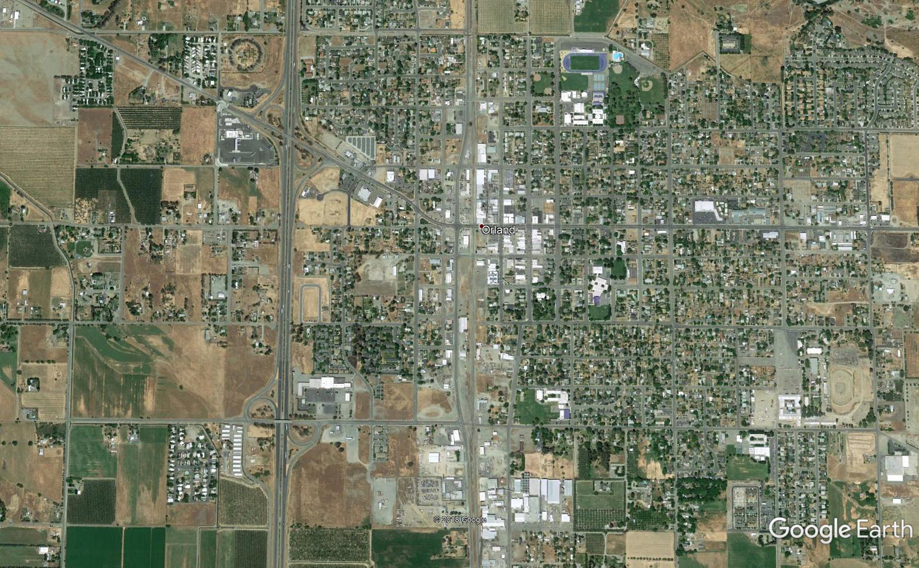
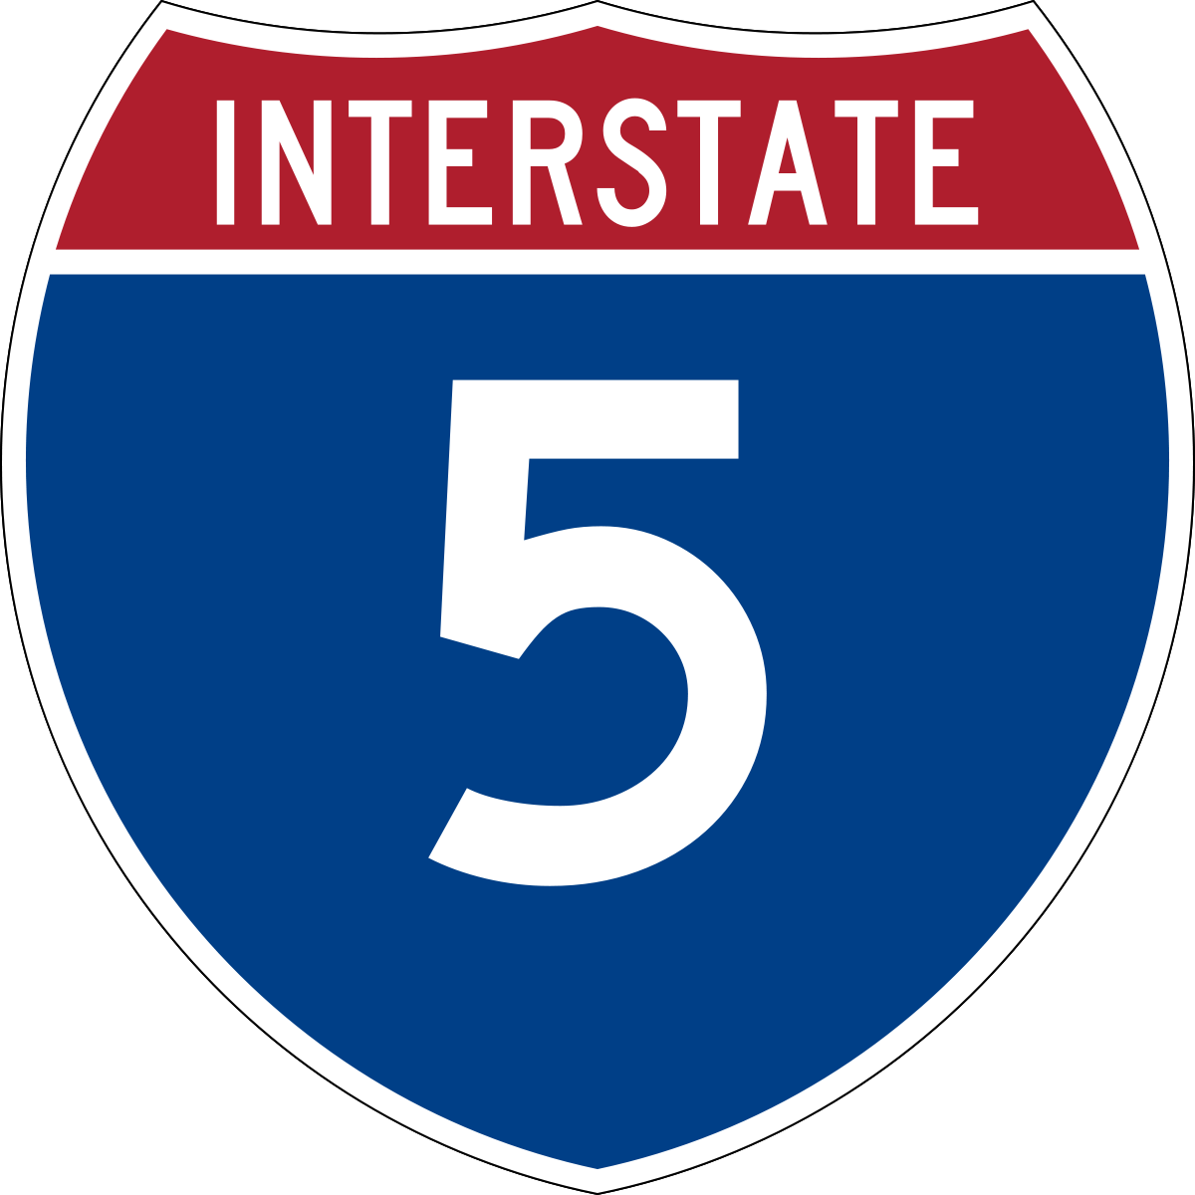



















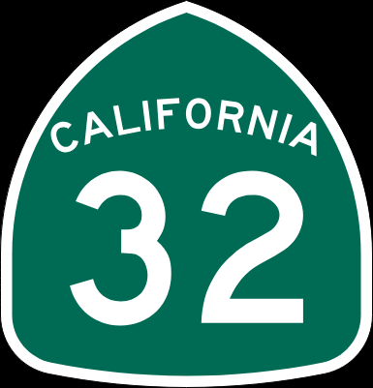








11,448 ADT
35,500 ADT

Slide 5


>200 acres available with I-5 exposure

Slide 6
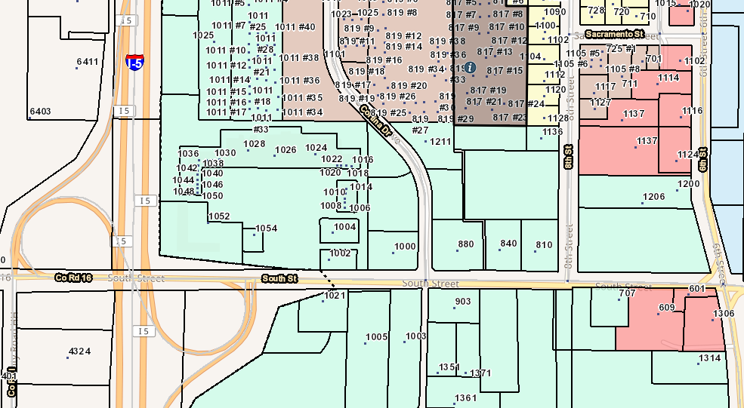
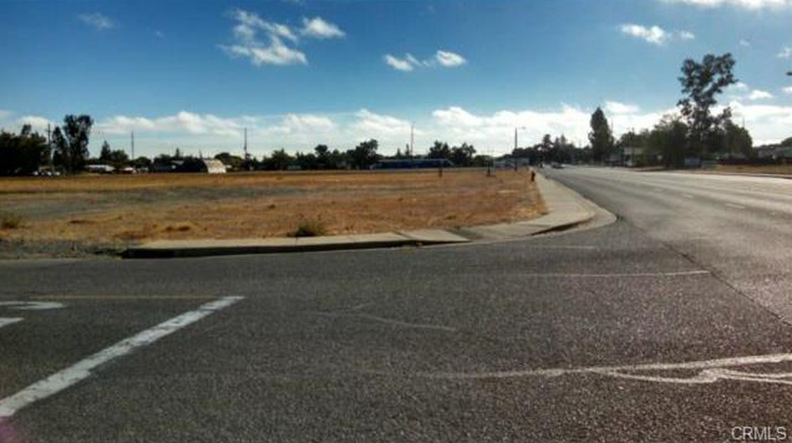


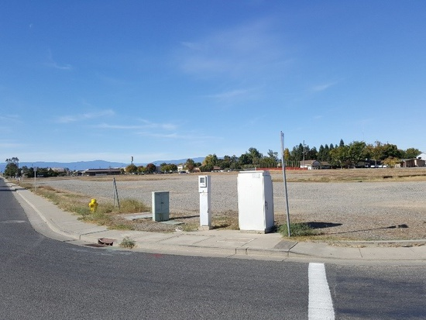
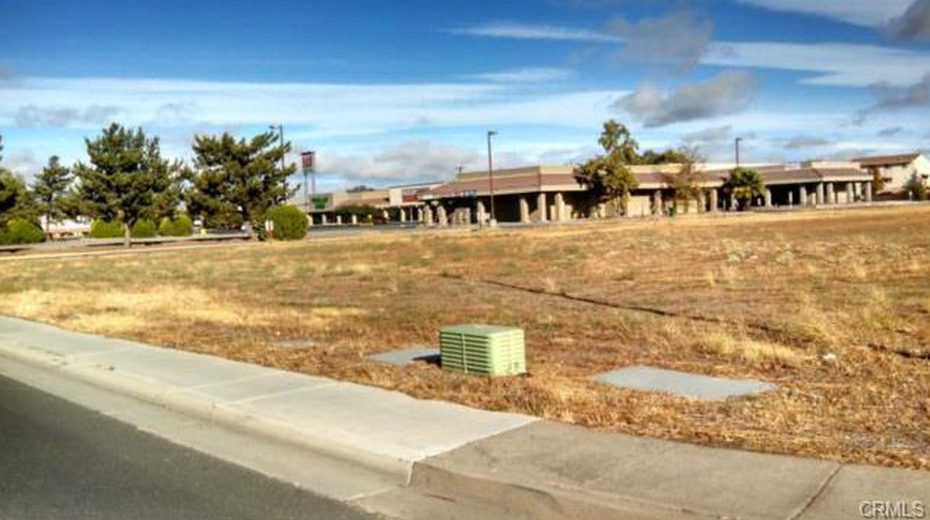
City utilities
Zoned Commercial
South St @ 6th, 7th, Cortina
12 parcels
.5 ac to 3.0 ac

Slide 7
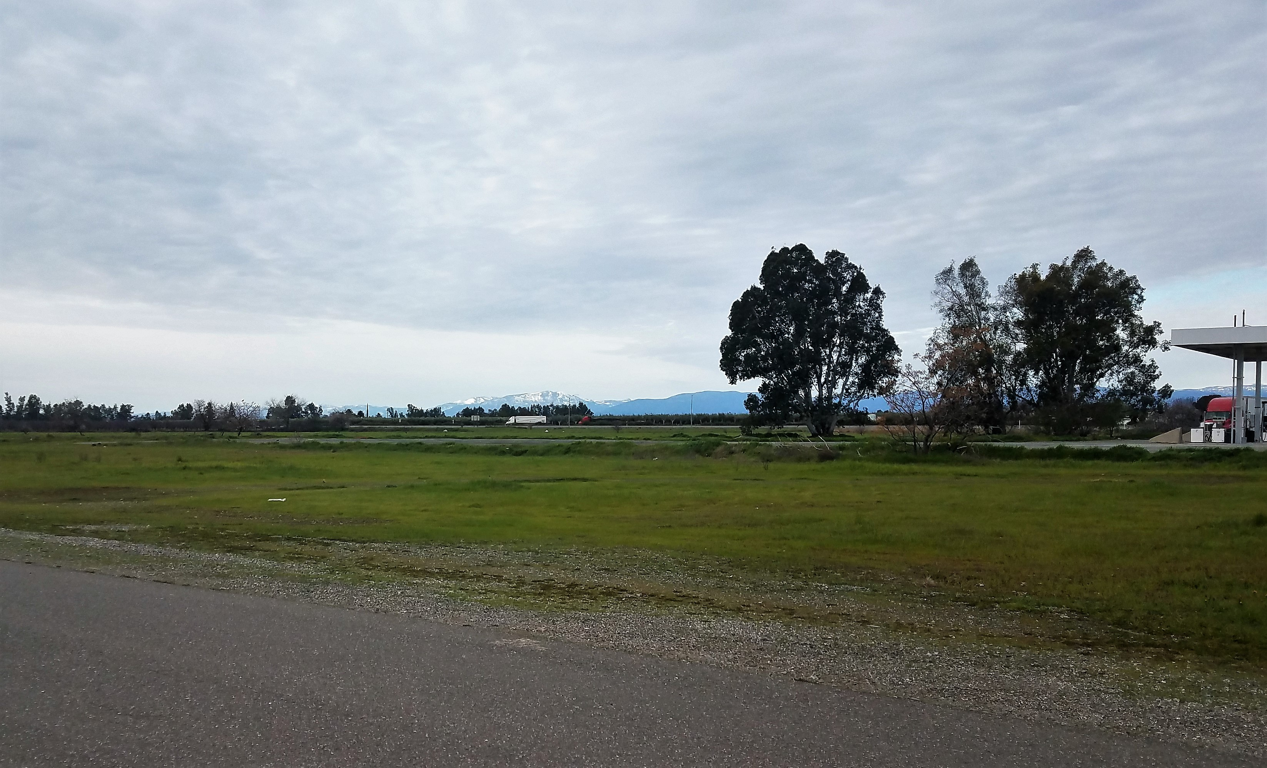
18 acres @ I-5 interchange
with access street

Slide 8
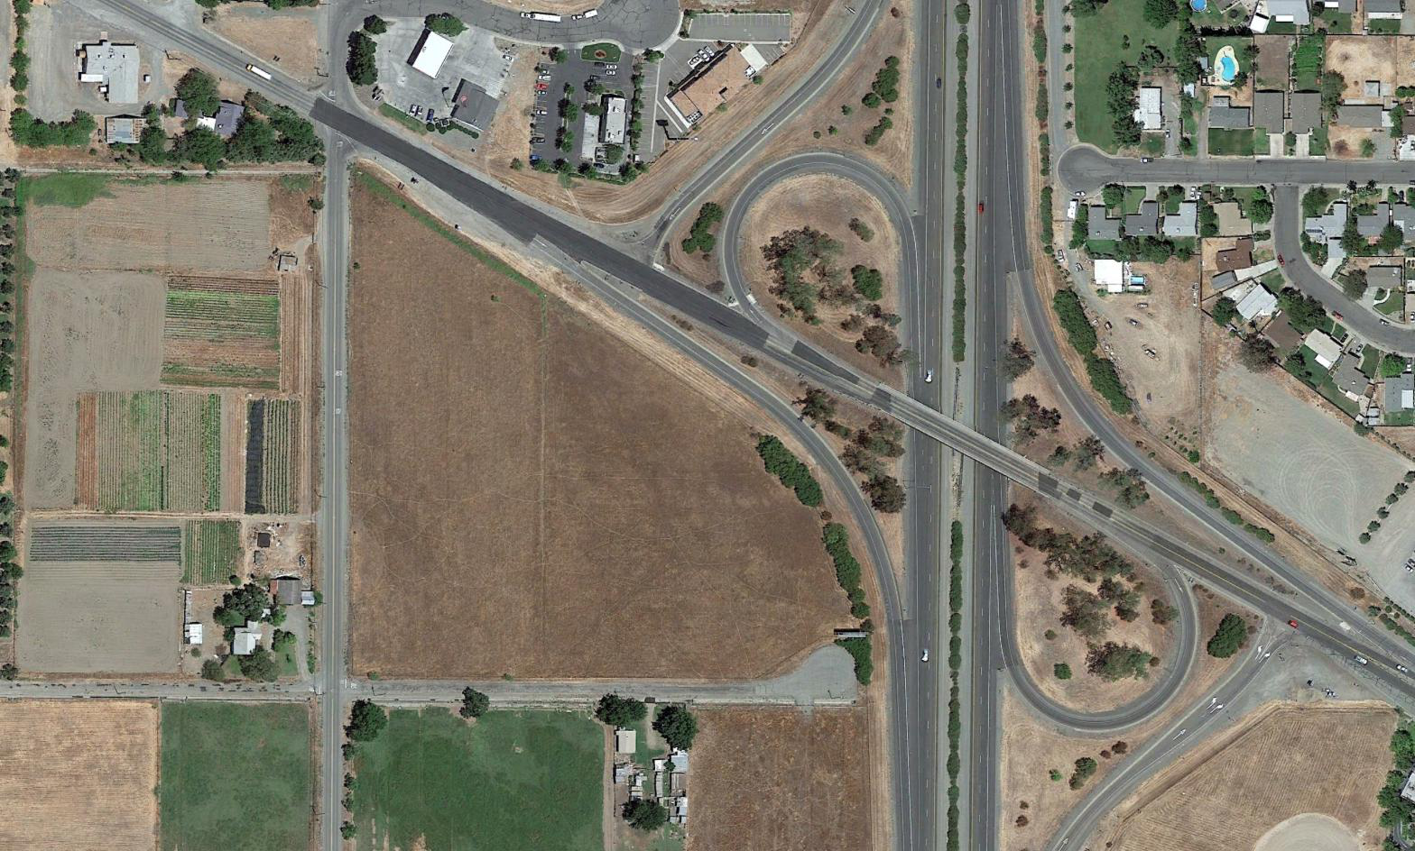
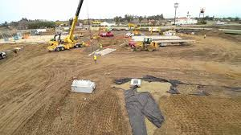

Slide 9
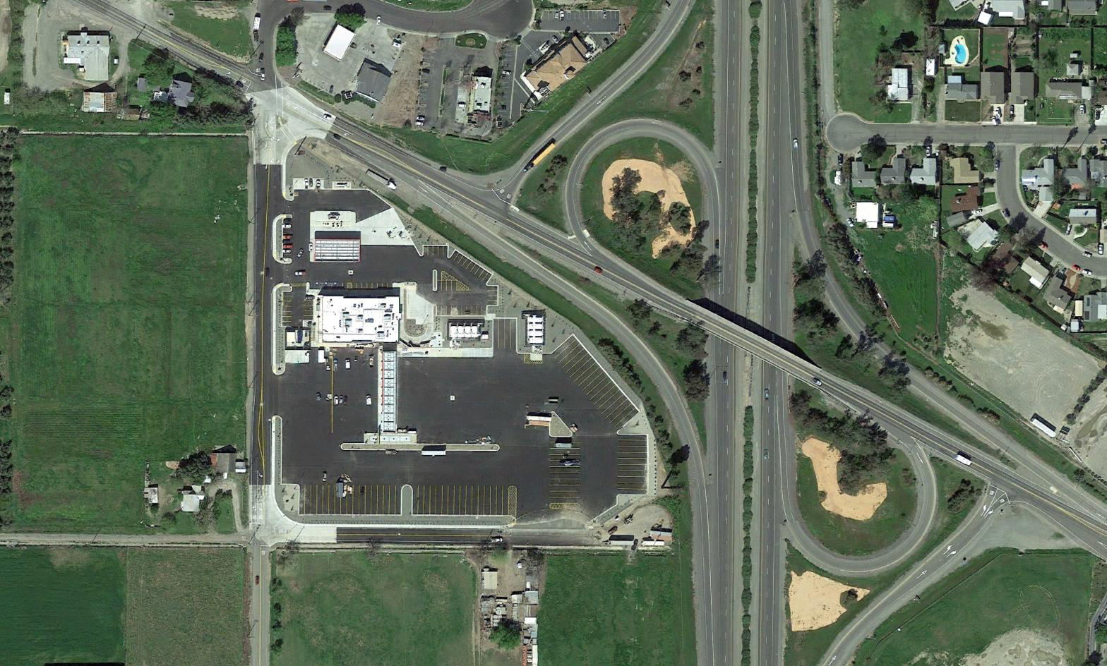
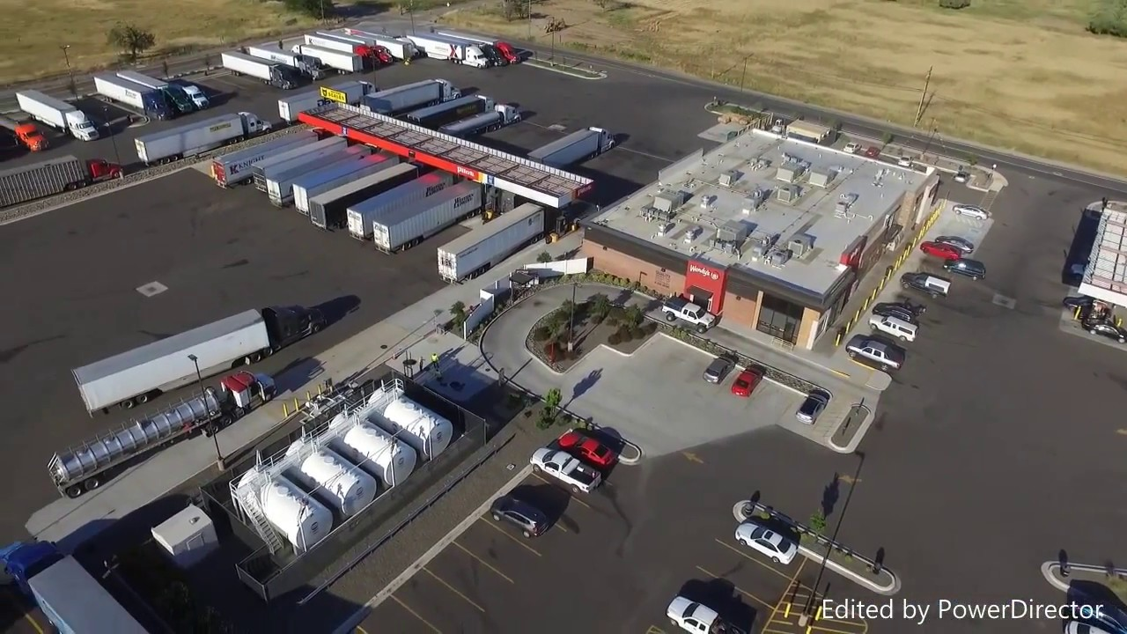
17 months later!

Slide 11
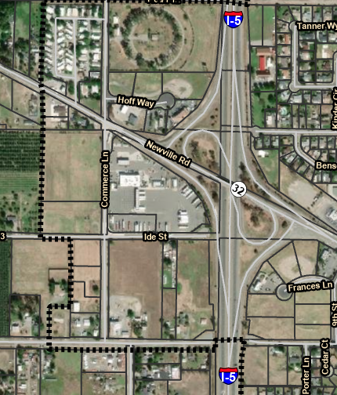

Ideal hotel site
Great potential locations
for hotels
Approved hotel – restaurant site
Ideal hotel – restaurant Site

Slide 12
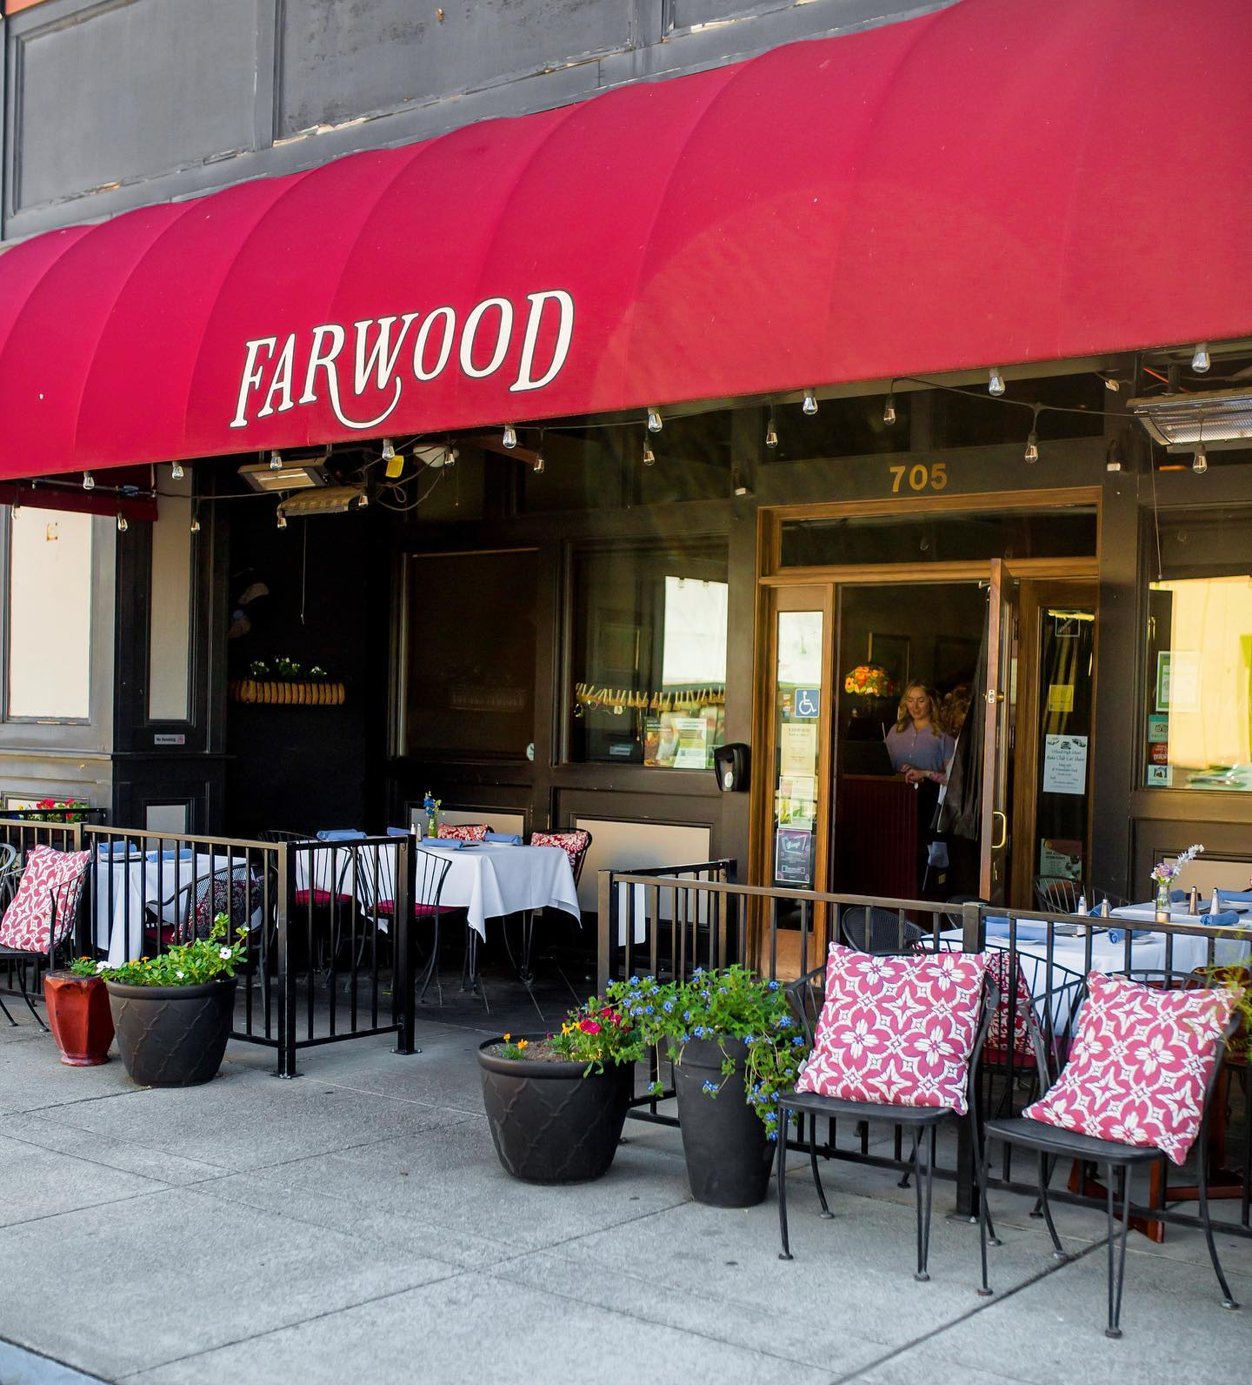
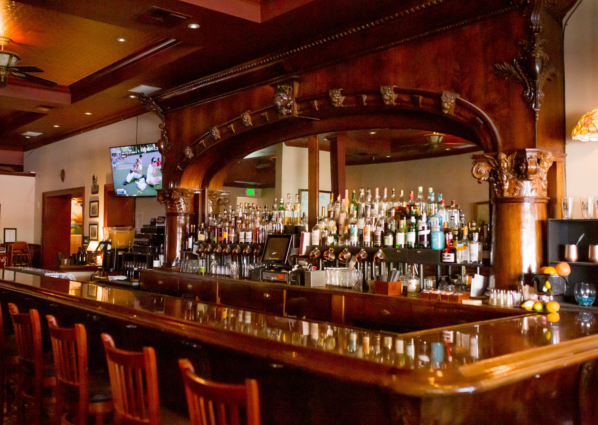
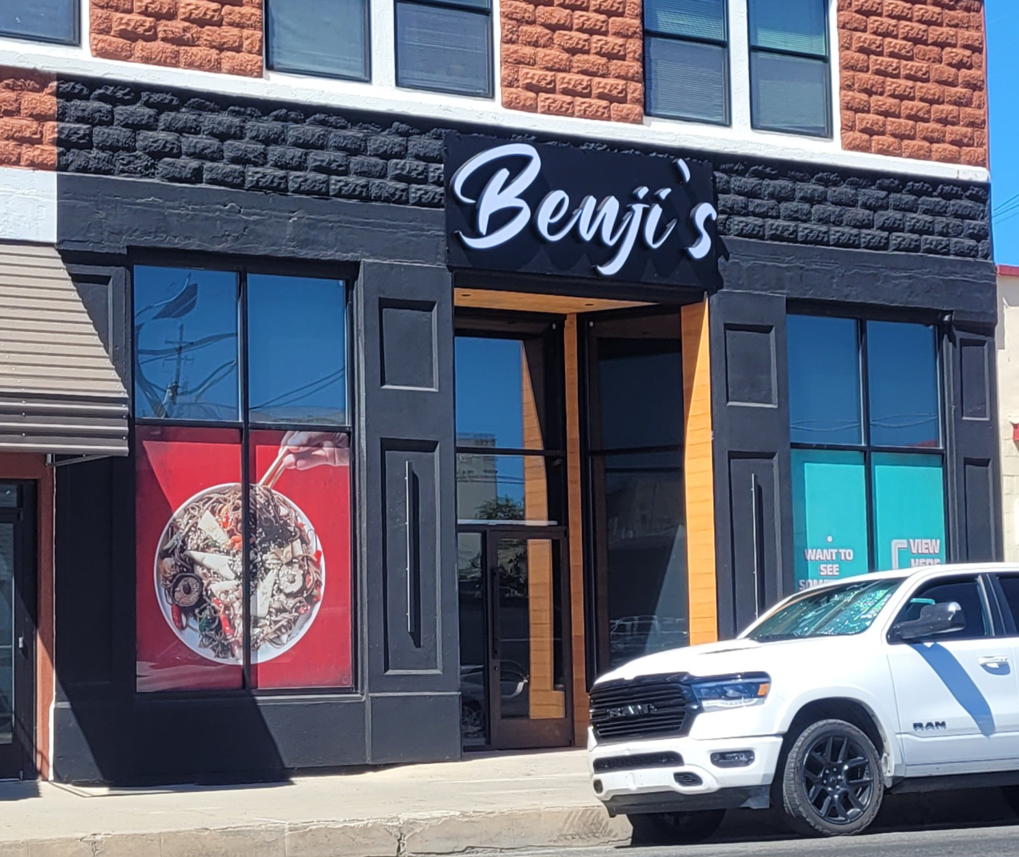
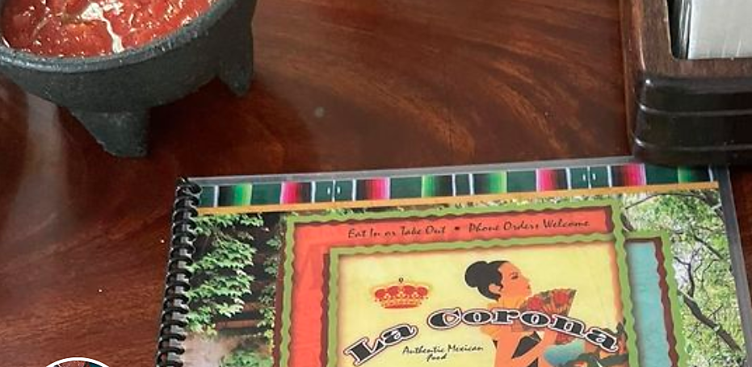

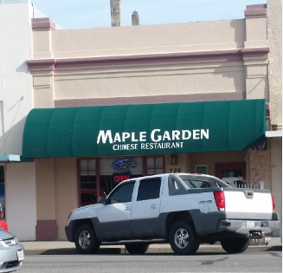
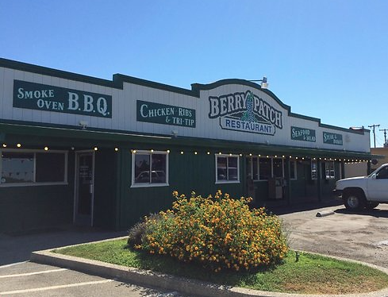


Excellent locally-owned
dining establishments

